Slide 1
Green S.E.E.D.S. Vela Luka High School
1.09.2019.-1.8.2022.

Slide 2
3 teams= 3 SeedQuests
forest as a socio-economic value
Green Team
Nature and
biodiversity;
protection of the natural ecosystem
sea without plastic
Blue Team
coast as a cultural and socio-economic value
Yellow team

Slide 3
Main topics

Slide 4
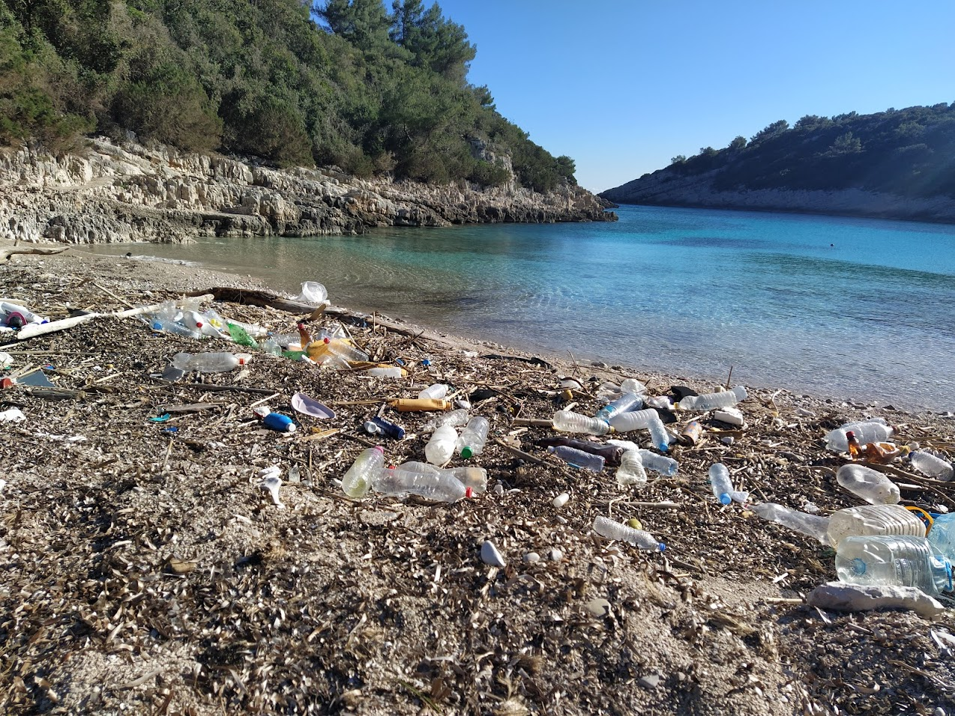
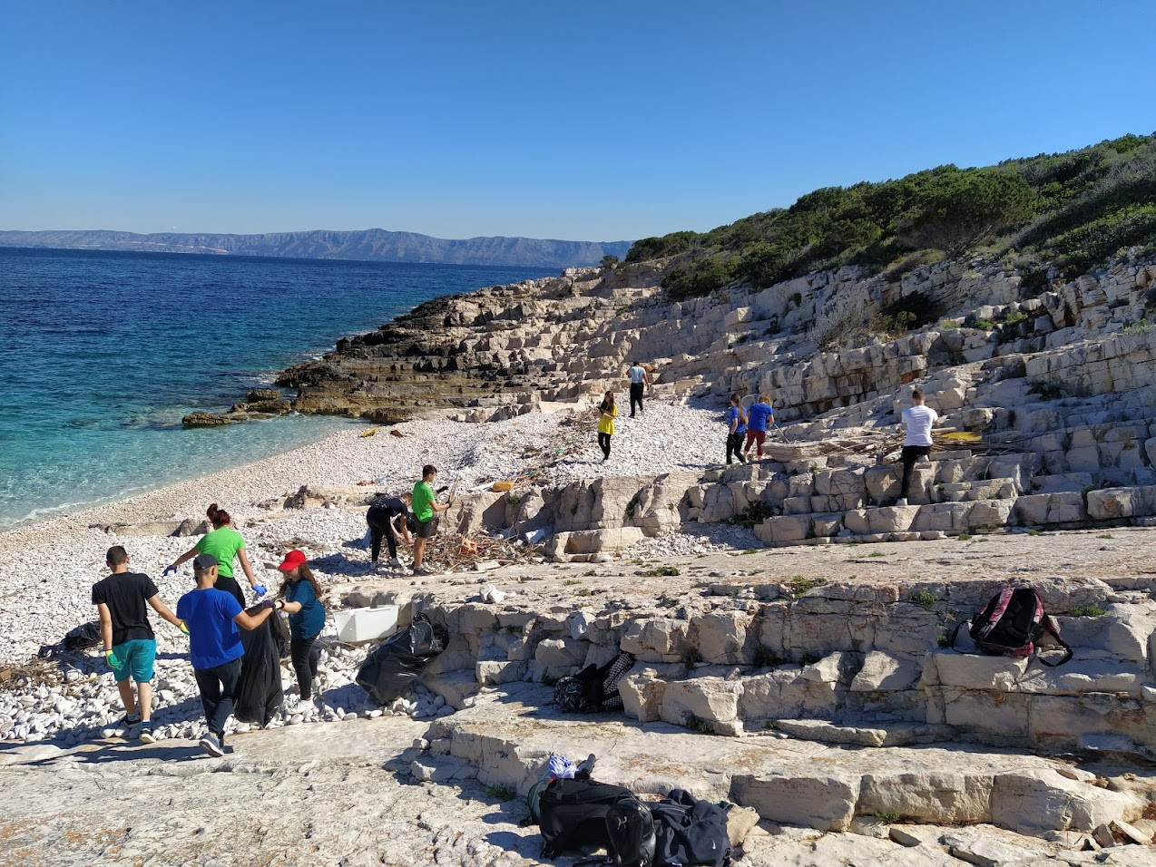
The main environmental problem today is plastic.
Much of the plastic waste ends up in the sea.
How to solve the problem of plastic in the sea?
sea without plastic
Blue Team

Slide 5
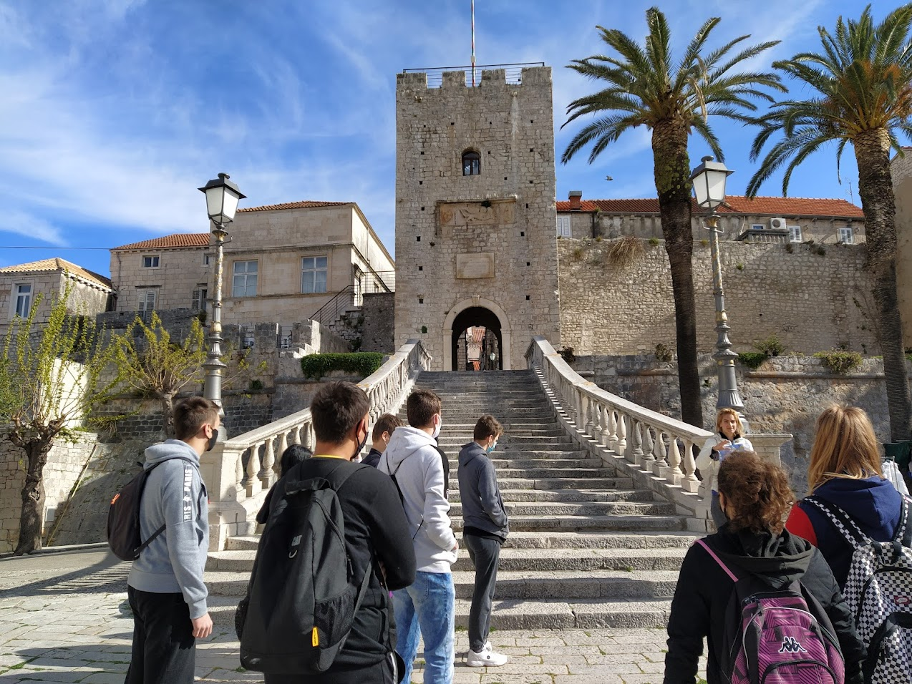
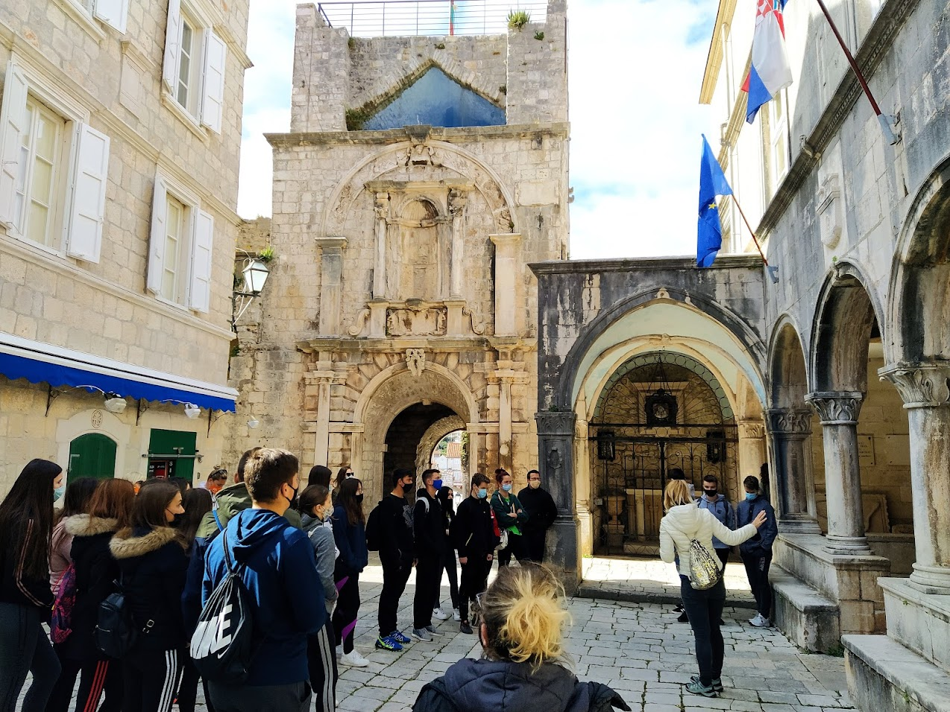
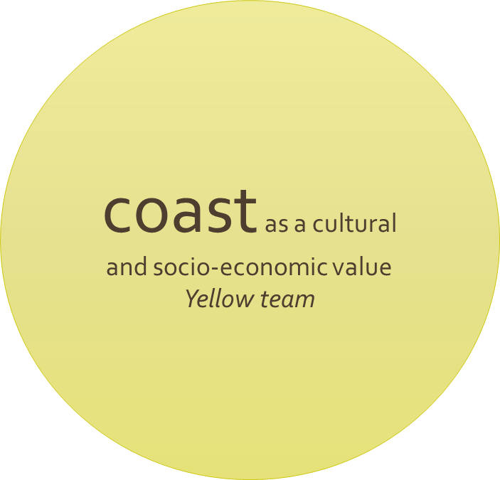
The life of the people on the island.
The impact of man on nature.
How to preserve the natural ecosystem with a modern way of life?

Slide 6
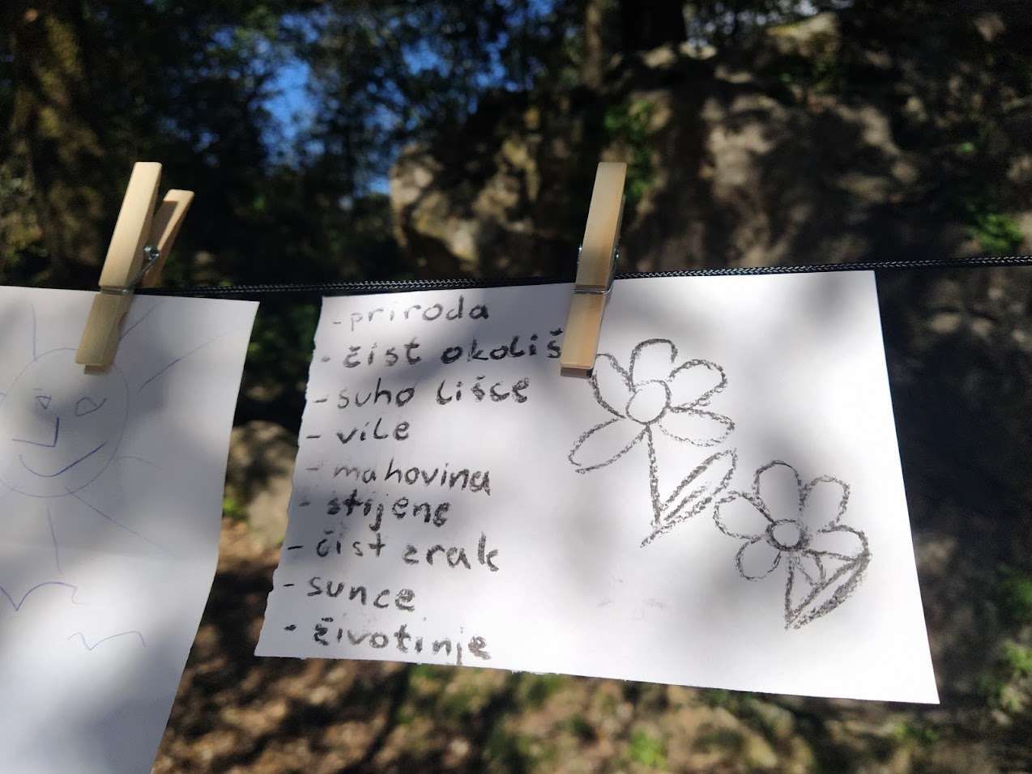
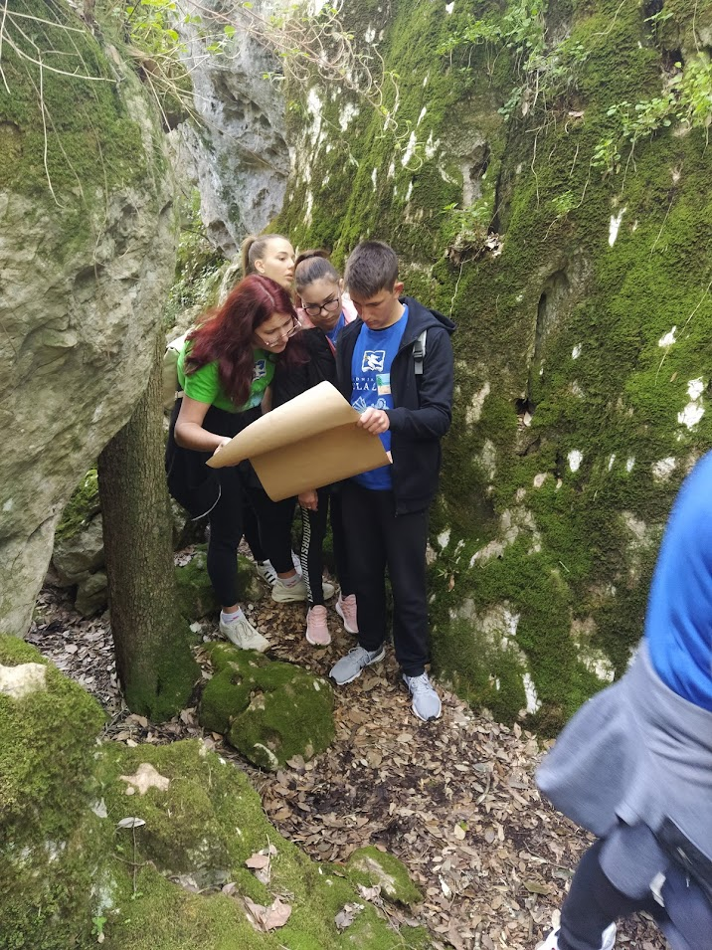
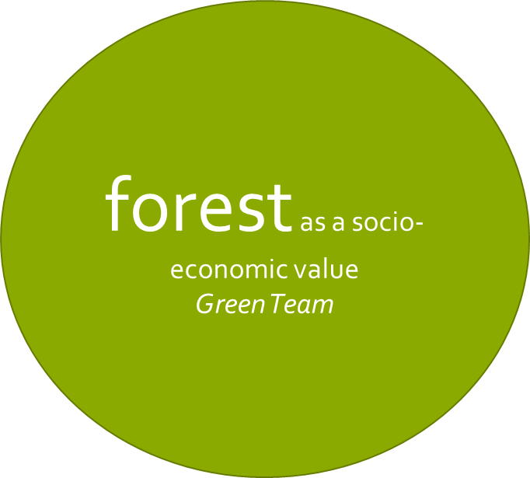
Island ecosystem - the island flora.
How did man influence the island's flora ?
We are looking for models for a better coexistence of islands and humans.

Slide 7
The methodology used to make the Seedquests

Slide 8
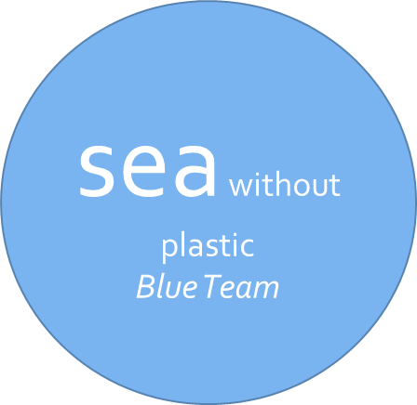
discussion of marine pollution via the Mentimeter app and Padlet app
waste analysis - how many years it takes to decompose
waste analysis - recycling
waste analysis - how much waste the average person makes per year
plastic impression calculation – Plastic Footprint Calculator app
documentary „Life on our planet”- impressions of the film - poster - Canva app
discussion - method 6 hats
treasure hunt method
field teaching - the town of Žitna bay and the island of Proizd

Slide 9
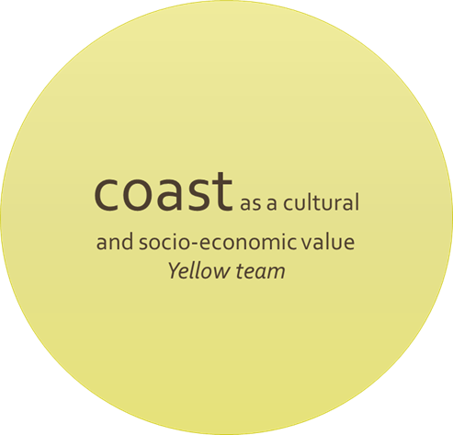
brainstorming - reducing the negative impact of man on nature
debate - the impact of tourism on the ecosystem of the coast of the island of Korcula
designing a tourism product that unites tradition and the present
interview method- life on the island then and now:
results presented to others through a PPT presentation
field teaching - the town of Korcula and the island of Vrnik

Slide 10
research on the topic of "forest island" using books, internet ..
present the results through a presentation tool
make a time map with events relevant to the island’s forests –Pikchart App
plant identification through the application- Pl@nt NET App
knowledge about medicinal herbs – Mentimeter App
debate - whether "hidden" localities should be popularized for tourism
all phases of the work recorded through the Prezzi presentation
field teaching Kočje Nature Reserve

Slide 11
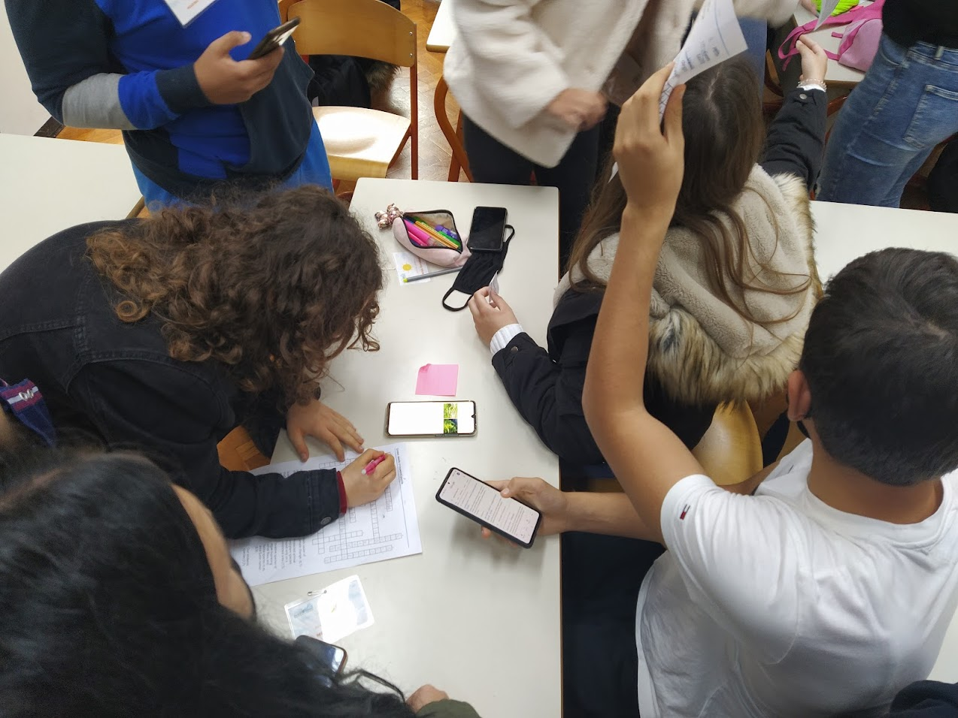
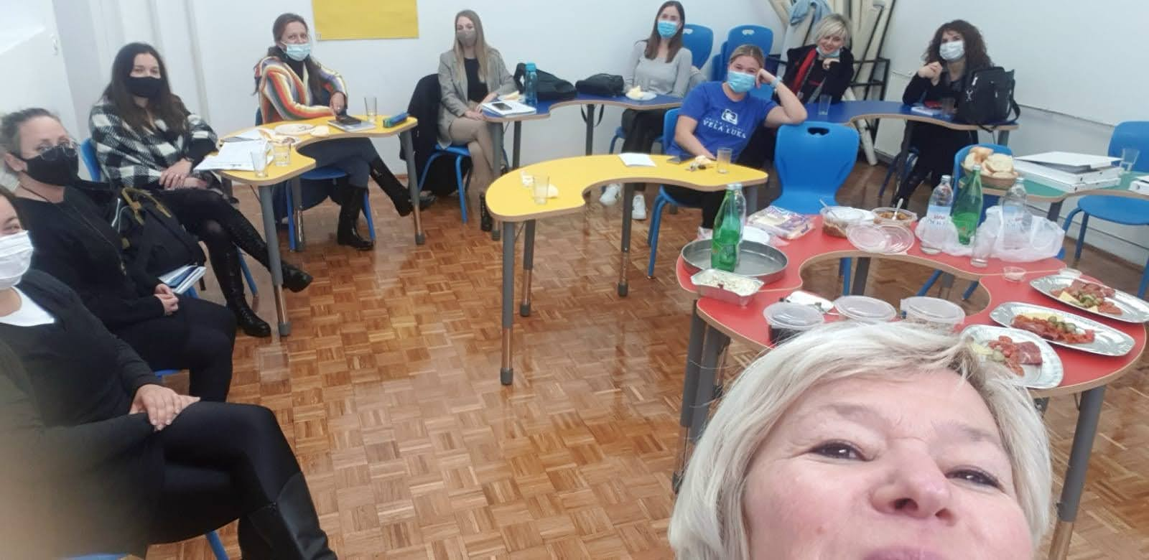
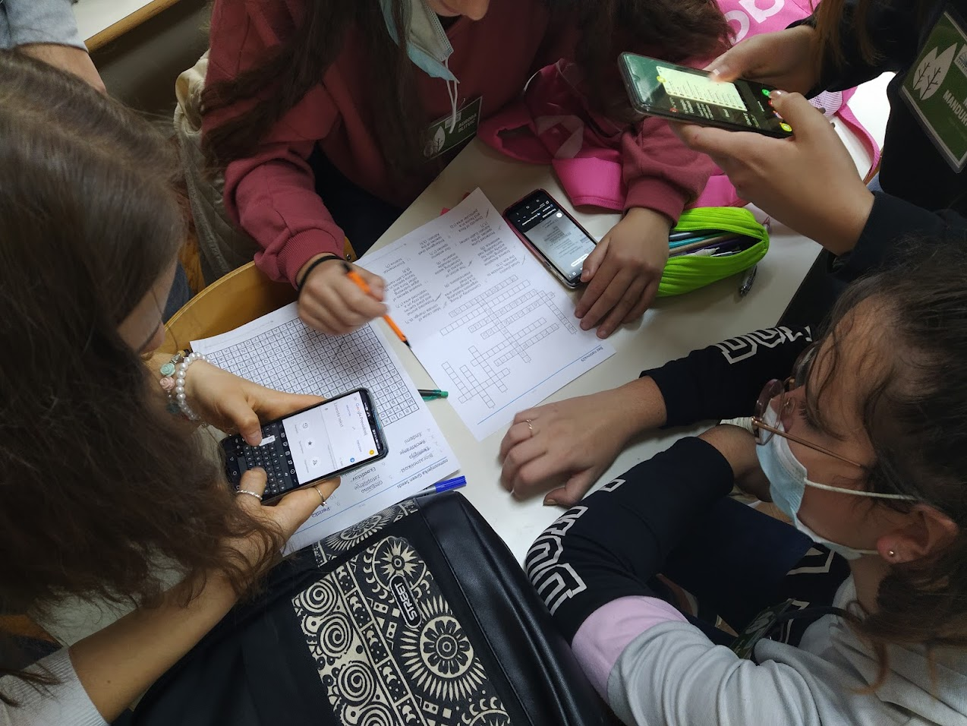
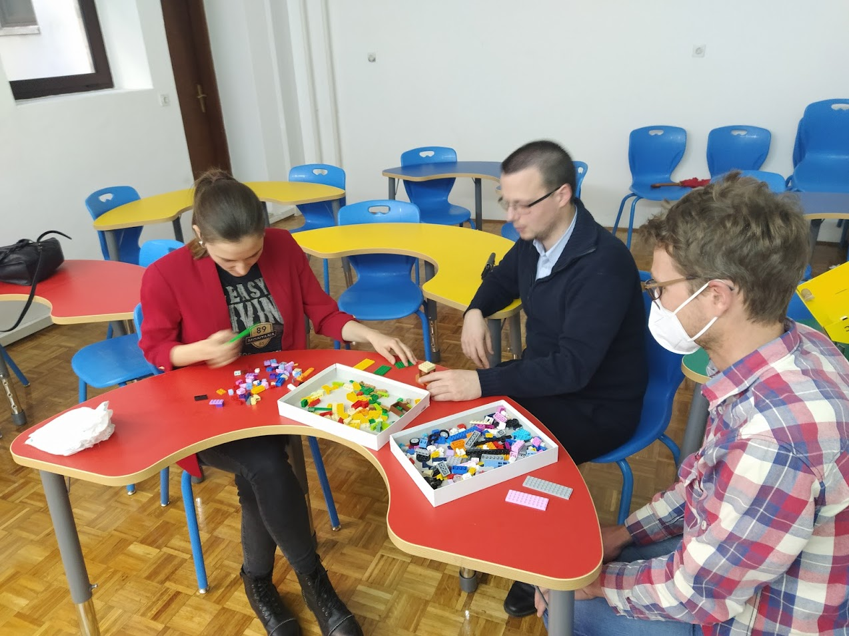
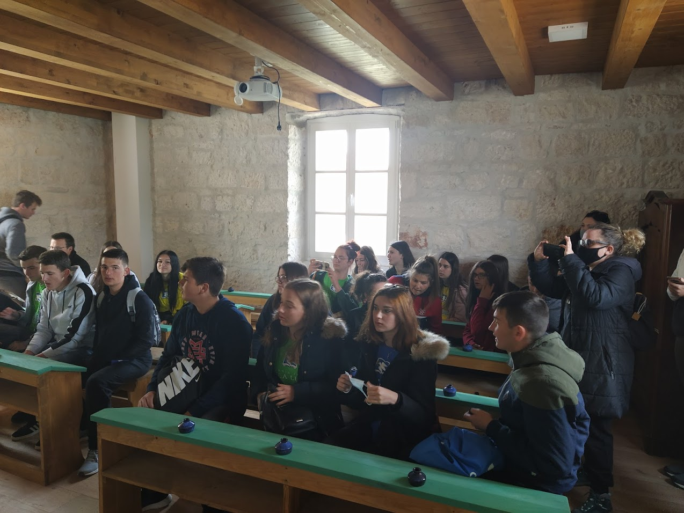
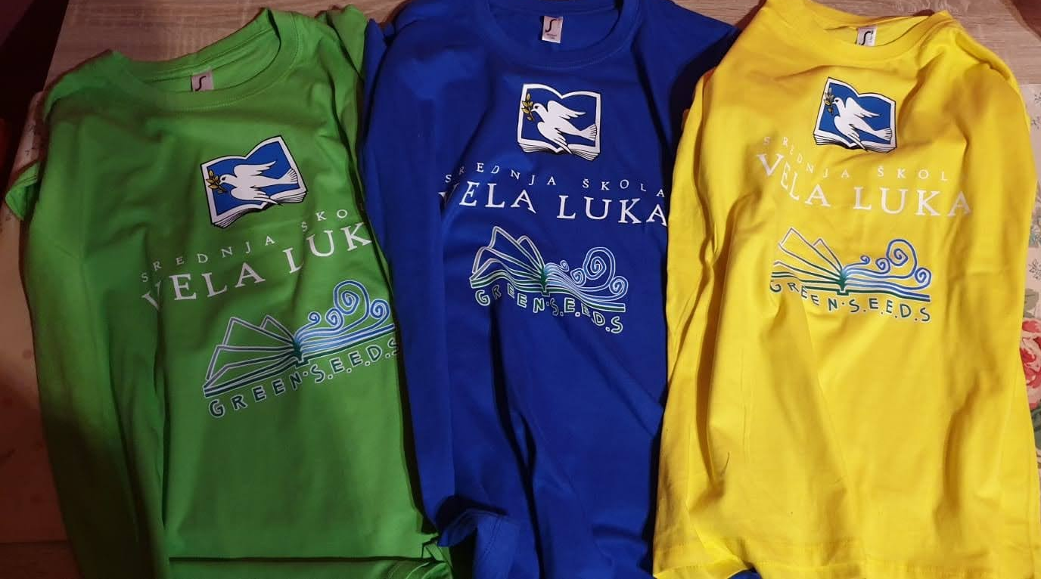
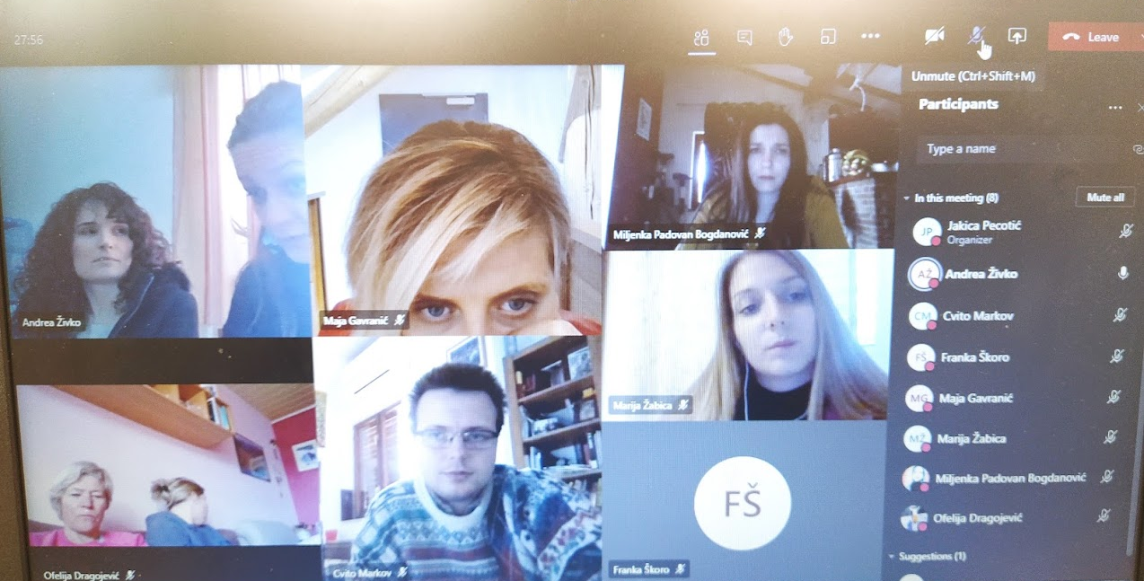
In school

Slide 12
Involment

Slide 13
students respond very well to topics aimed at preserving the environment - environmental topics
students prefer fieldwork to classroom instruction
students excel in the online environment, that is, in using the online application

Slide 14
Final product

Slide 15
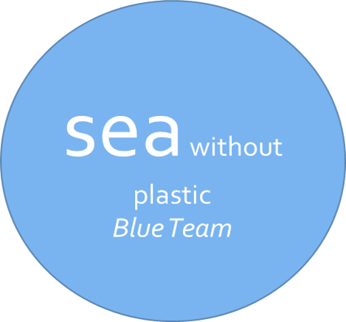
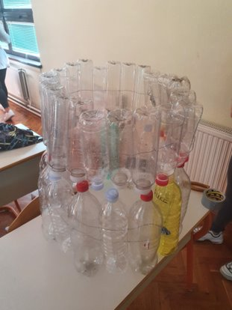
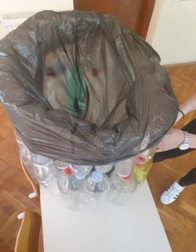
a trash can made from collected plastic bottles

Slide 16
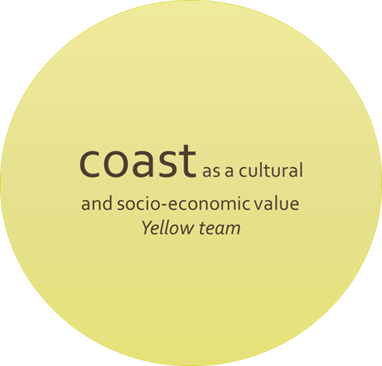
poster - student idea invite everyone interested in the grape harvest

Slide 17
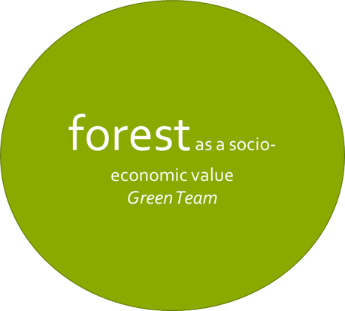
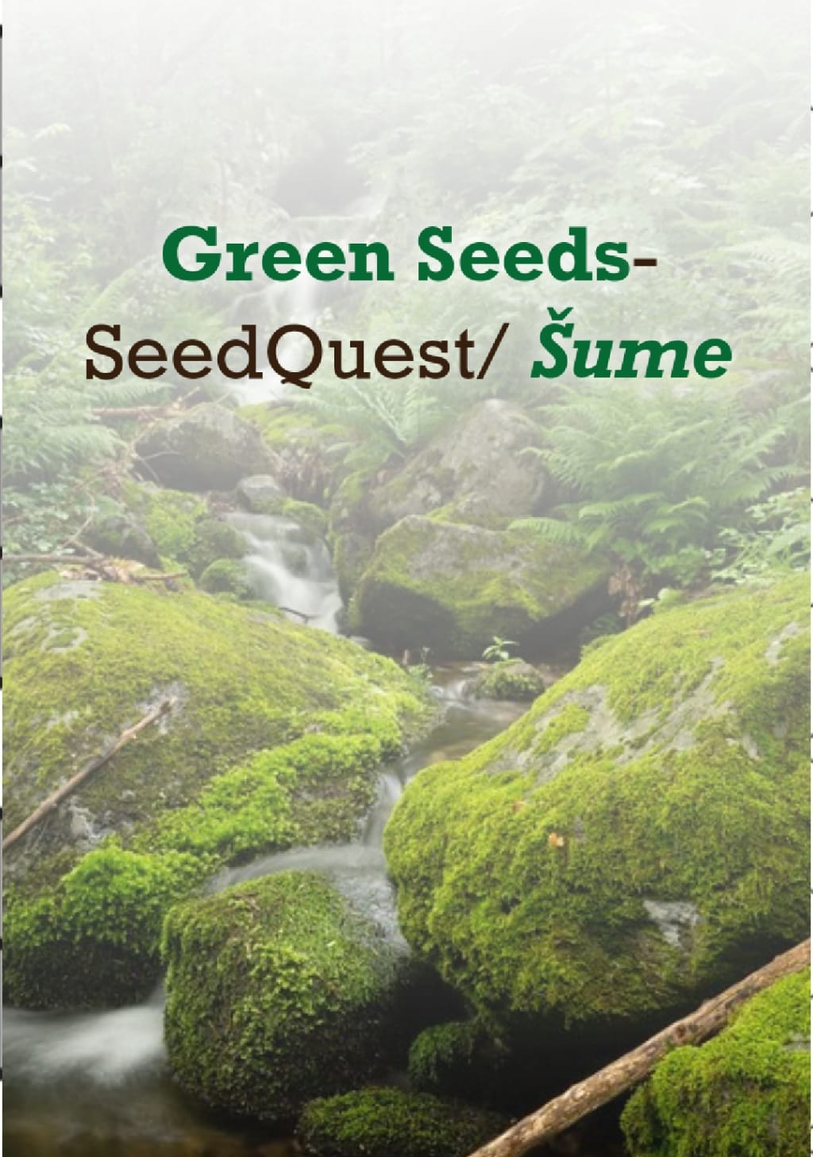
Sway
presentation of the green team

Slide 18
