Slide 1
EU Textiles Strategy and ReSet the Trend campaign
European Commission
DG Environment

Slide 2
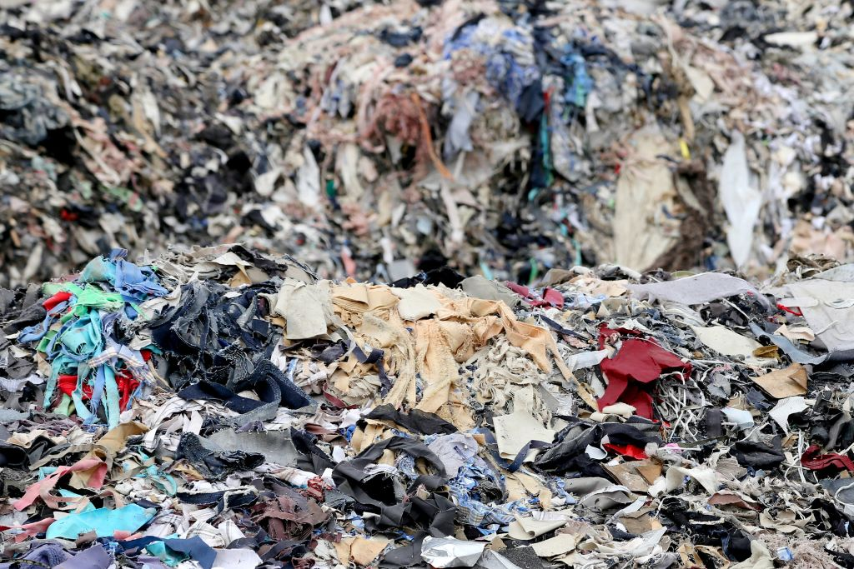
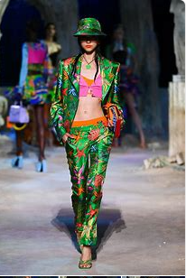
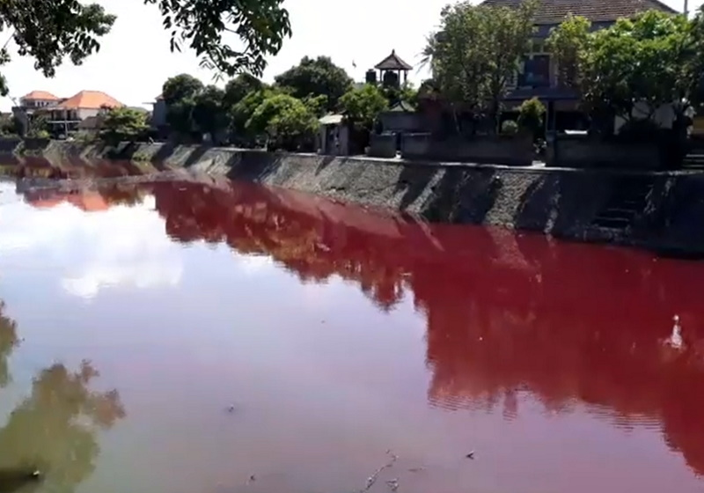
BUT
Notes:
Why are textiles a problem? Photo on the left seems harmless – just about expressing yourself through clothes
Well, the reality is different:
Highest impact on environment & climate change – image of river turned red because of nearby textile dyeing plant
11 kilos of waste/EU citizen every year – image of landfill

Slide 3
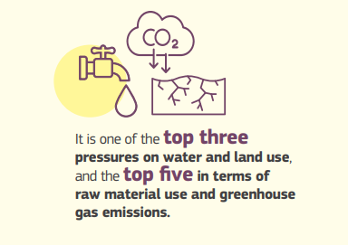
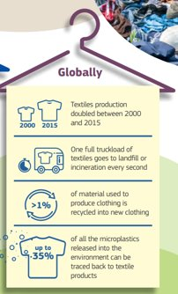
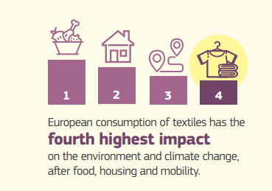
Textiles sector: challenges

Slide 4
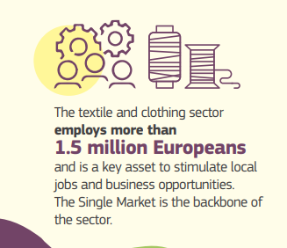
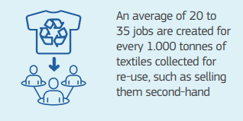
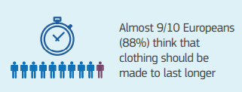
Textiles sector: opportunities
Increase the EU textiles ecosystem’s resilience
Boost its attractiveness, creative and innovative potential
Tap into new markets for sustainable textiles

Slide 5

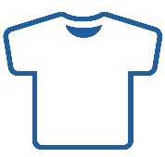
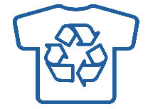

BY 2030
FAST FASHION IS “OUT OF FASHION”
FAIRLY MADE
DURABLE
REPAIRABLE
RECYCLABLE
SAFE
CLOTHES ARE:
Notes:
Vision by 2030.
Headline statmeent: fast fashion will be out of fashion
Instead, our clothes will be made in good conditions, will be high quality, repairable, recyclable and free of hazardous substances

Slide 6
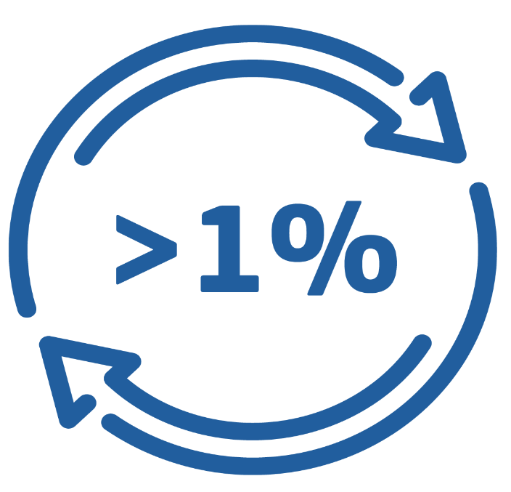
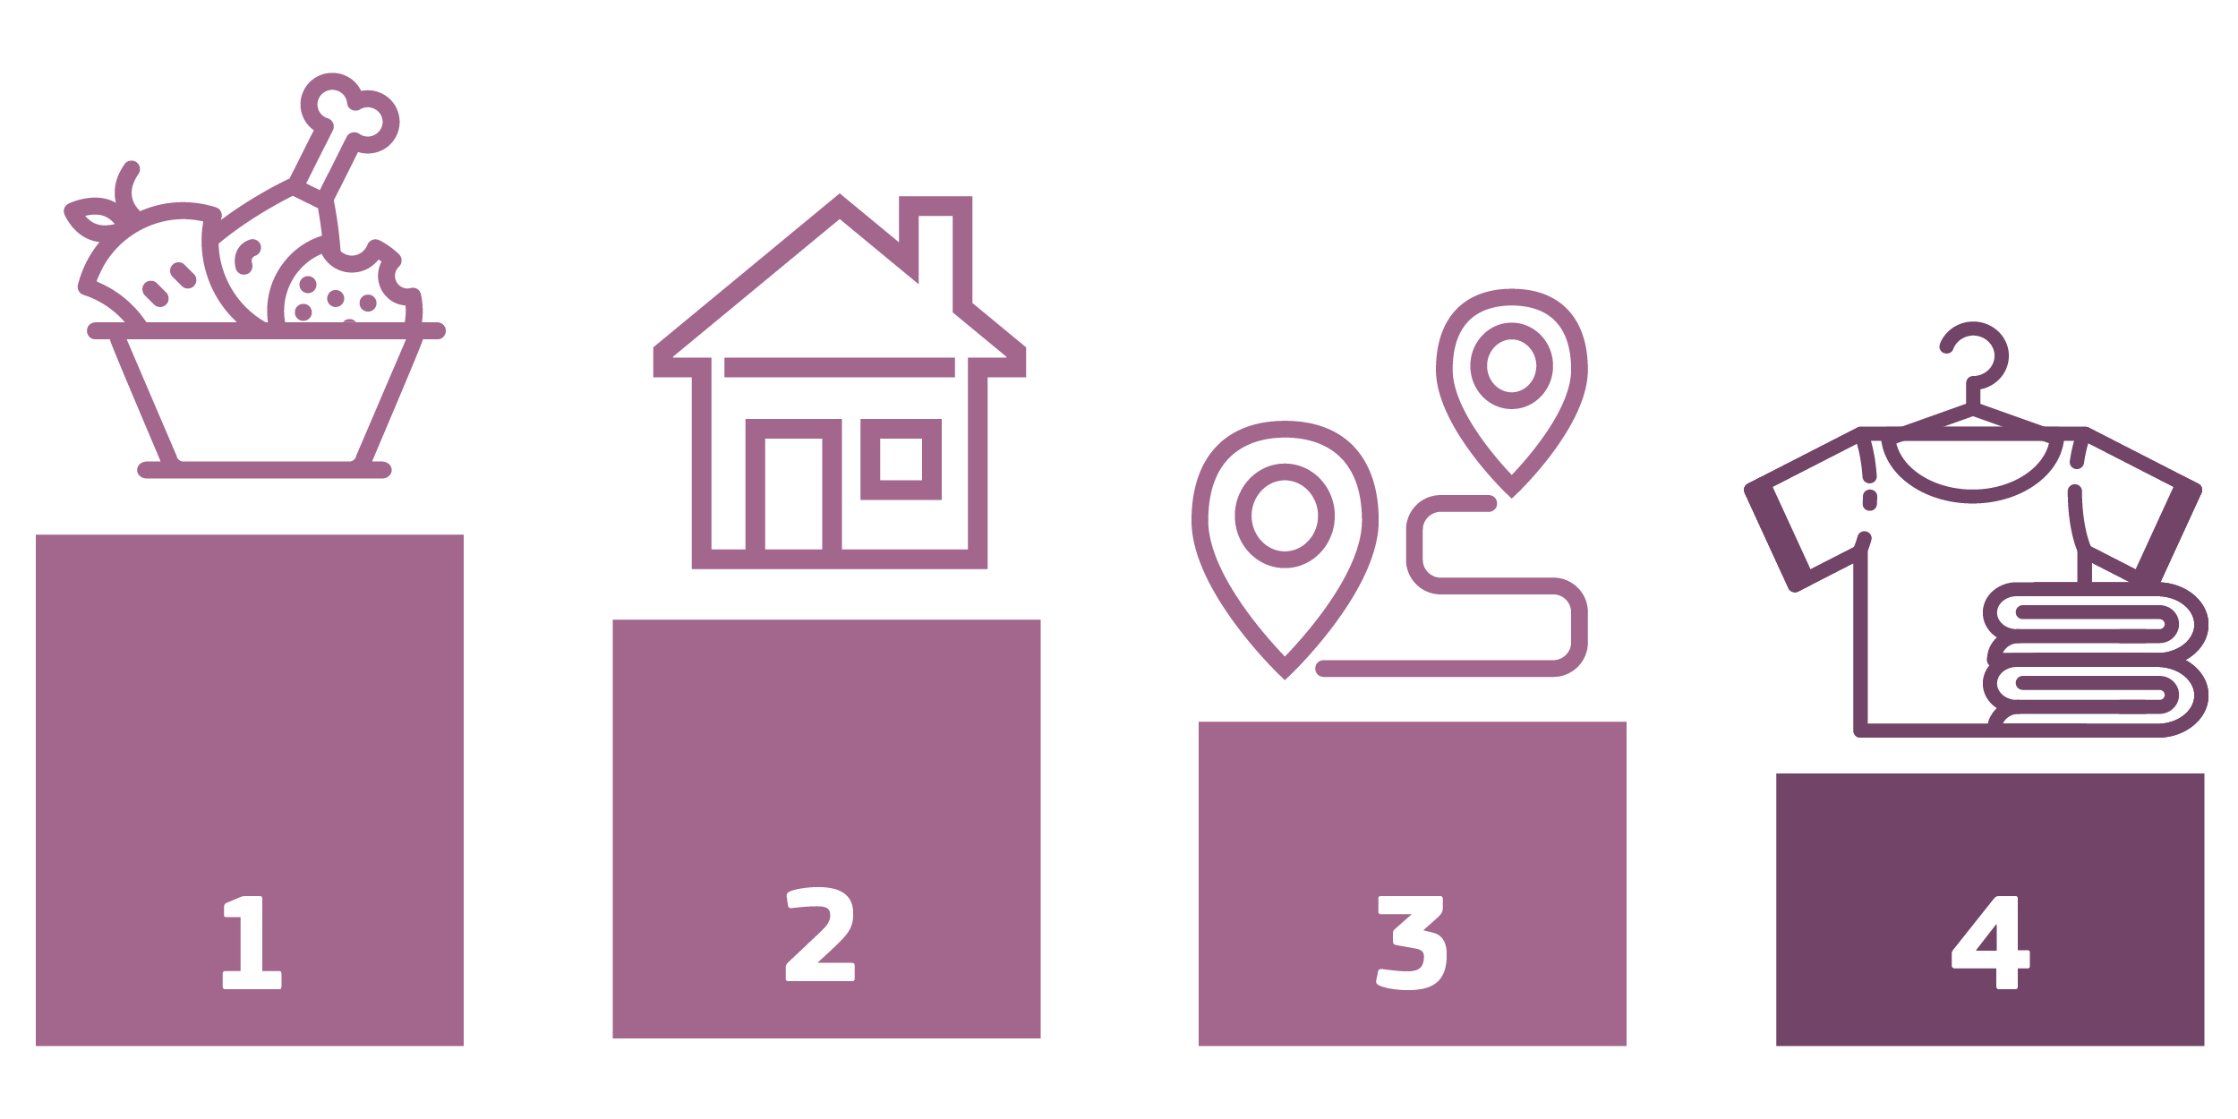
BY 2030
CIRCULAR, NOT THROW-AWAY!
WIDELY AVAILABLE RE-USE & REPAIR SERVICES
INCREASED PRODUCER RESPONSIBILITY
Notes:
Continuation of vision
Headline statement: circular not throw-away fashion. We will achieve this by ensuring re-use & repair services are widely available, by ensuring producers are responsible for thier products throughout their lifecycle which will help ensure clothes are better recycled, repaired etc.

Slide 7
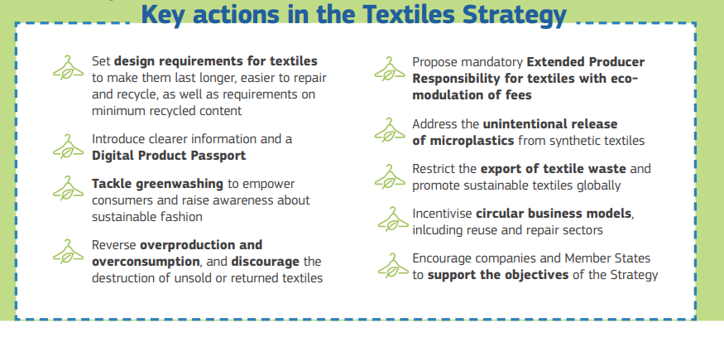
EU Textiles Strategy: key actions
Useful ressources :​
EU Textiles Strategy Factsheet​
EU Strategy for Sustainable and Circular Textile

Slide 8

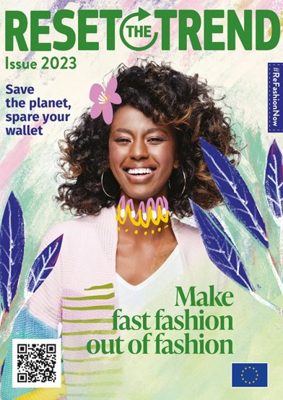
Changes in textile / fashion industry will involve everyone: designers, producers, retailers and consumers
To engage consumers, the European Commission launched ''ReSet the Trend - #ReFashionNow'' - an awareness-raising campaign on sustainable fashion
Targets: Young Europeans, with focus on six countries (Belgium, Greece, Italy, Lithuania, Romania, Spain)

Slide 9
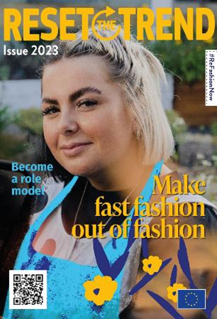
- Objectives
Engage citizens, in particular young Europeans, in making fast fashion ‘out of fashion’
Raise public awareness of the EU Strategy for Sustainable and Circular Textiles and its environmental, social, economic, health-related benefits; and illustrate sector's potential in saving water, energy and other resources; and tackling pollution
Position the Strategy as a necessary measure in the time of multiple crises, incl. natural resource and cost-of-living crises

Slide 10
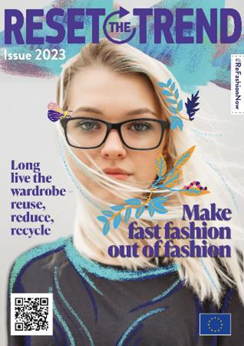
- Underlying concept
Everyone can be a role model and help transform the textiles sector
Through our daily choices, we all have a role to play in transforming the textiles sector and making it more sustainable.
Become a role model, help make fast fashion out of fashion – and inspire others by sharing examples of your actions!

Slide 11
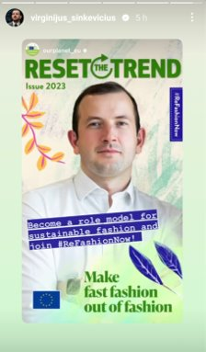
- Get involved!​
Use the campaign hashtag #ReFashionNow
Use, share and promote the campaign materials:
  website https://environment.ec.europa.eu/topics/circular-economy/reset-trend_en
  Videos - Share from Youtube
  Use IG filters - link here
  Visuals - download magazine covers; editable visuals
  Share inspirational stories from the textiles sector

Slide 12
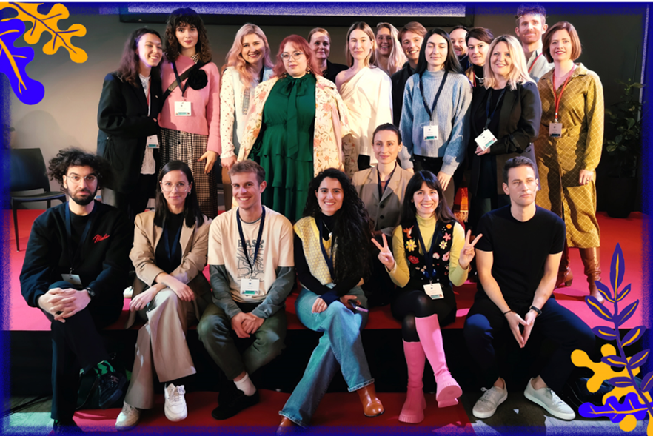
- Working with young Ambassadors
Belgium
@elisabeth.van.lierop​
Greece
@ashinyday​
Italy
@matteo.ward​
@parlasostenibile​
Lithuania
@bulbenkaite​
@dressedherring​
Romania
@patriciasvoice
Spain
@ally_viamalama​
@jonkareaga​

Slide 13
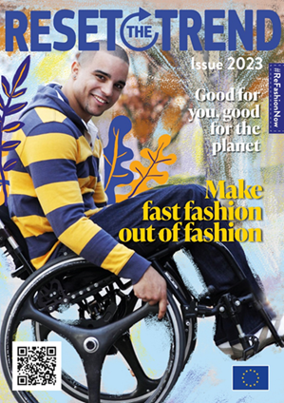
- Lessons learned
Young people are extremely committed and active – change is already happening!
… but this is not just an issue for young people: there is a role for everyone
We need positive messages; adapted to local situation / perception
This is a complex topic linking many different policy areas
The wider geo-political context matters
Working with influencers: a first for us!

Slide 14
THANK YOU!

