Slide 1
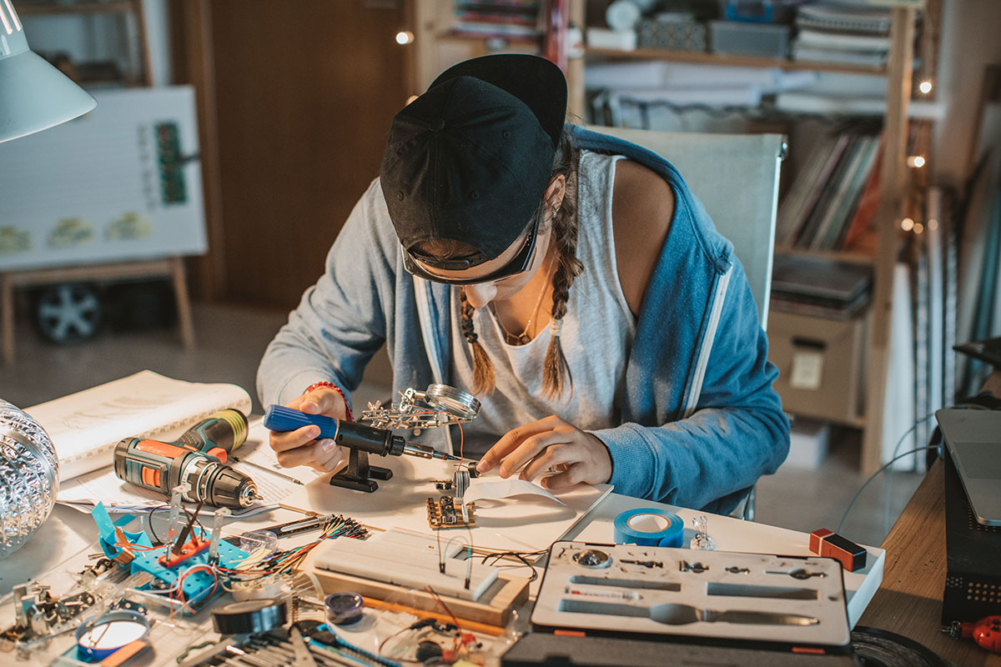


Sustainability Skills
About the programme
Unite regional initiatives around learning in transition
Collaboration vocational education, businesses, governments
Priority action areas Unesco ESD 2030
Impact and challenges

Slide 2
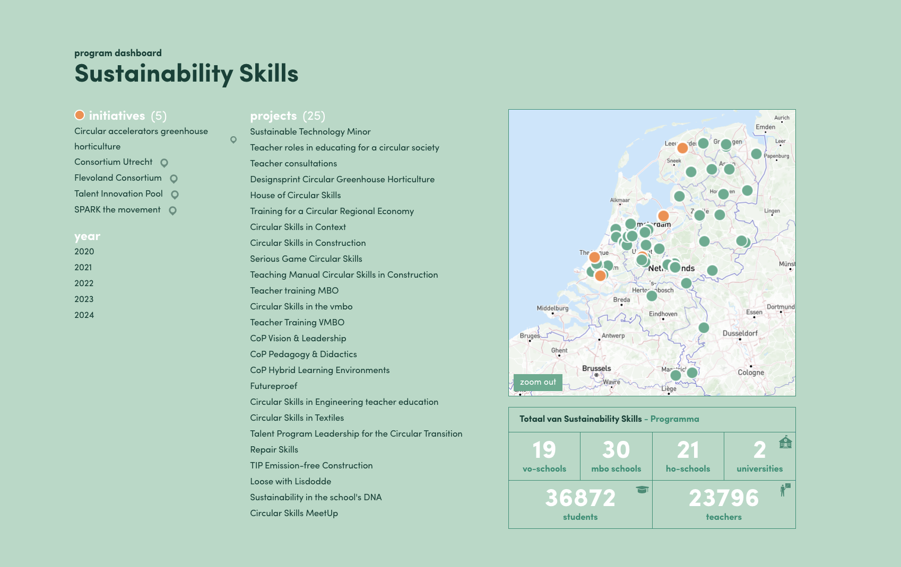

Slide 3
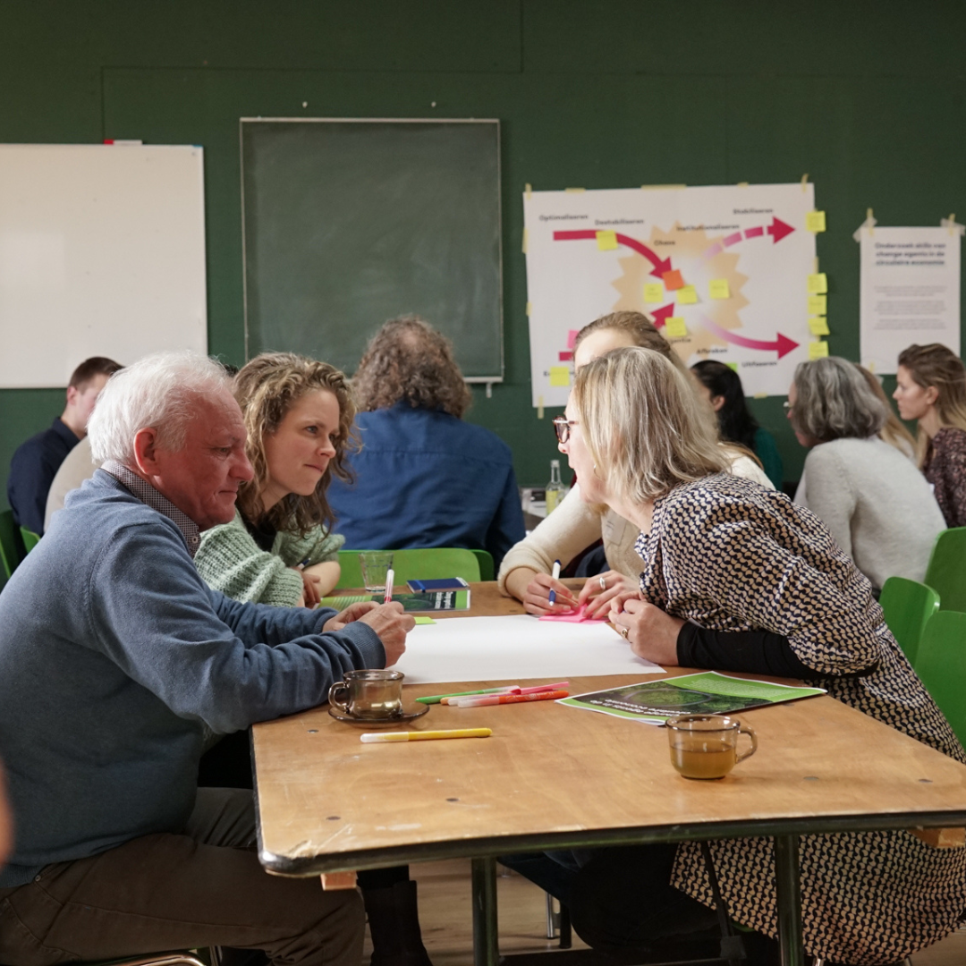



Get in touch!
Sustainability Skills
daan@lerenvoormorgen.org
@Coöperatie Leren voor Morgen
www.lerenvoormorgen.org

