Slide 1



  ACT – Active Collaborative Transitions Living Lab
  Master International Supply Chain Management
  Rotterdam Business School
Presentatie titel
  Dr. Biljana Pesalj
  Associate Professor
  Rotterdam Business School
  The Netherlands
Ir. Clarette Bonebakker
Project Leader Circular Business
Paardekooper BV
Rotterdam, 00 januari 2007

Slide 2


Urgency to improve sustainability
Need for sustainability information is rising
  Life Cycle Assessment (LCA) – environmental impact along the life cycle of a product (ISO 14040 and 14044)
Regulations are pressing – directly or indirectly (via the supply chain)
  CSRD
  PEF (Product Environmental Footprint) & OEF (Organization Environmental Footprint)
  Food sustainability labelling and claims
  Carbon footprint reduction
Mismatch at the labor market between demand and supply of sustainability talent

Slide 3
Carbon footprint calculation and reduction strategies
Collaborative learning environment with engaged students, lecturers, researchers, companies, associations, authorities and experts
Collaboration with innovative industry and academic partners that offer practical tools (software & methodologies) to enable students to:
  apply Life Cycle Assessment methodology (Mobius software and EcoInvent data sets)
  generate data driven insights
  develop strategic recommendations for carbon footprint reduction in the supply chain
  rethink current business practices & revenue models and supply chains (collaboration opportunities)
Accelerate transition/transformation toward a circular economy & more sustainable business and society

Slide 4




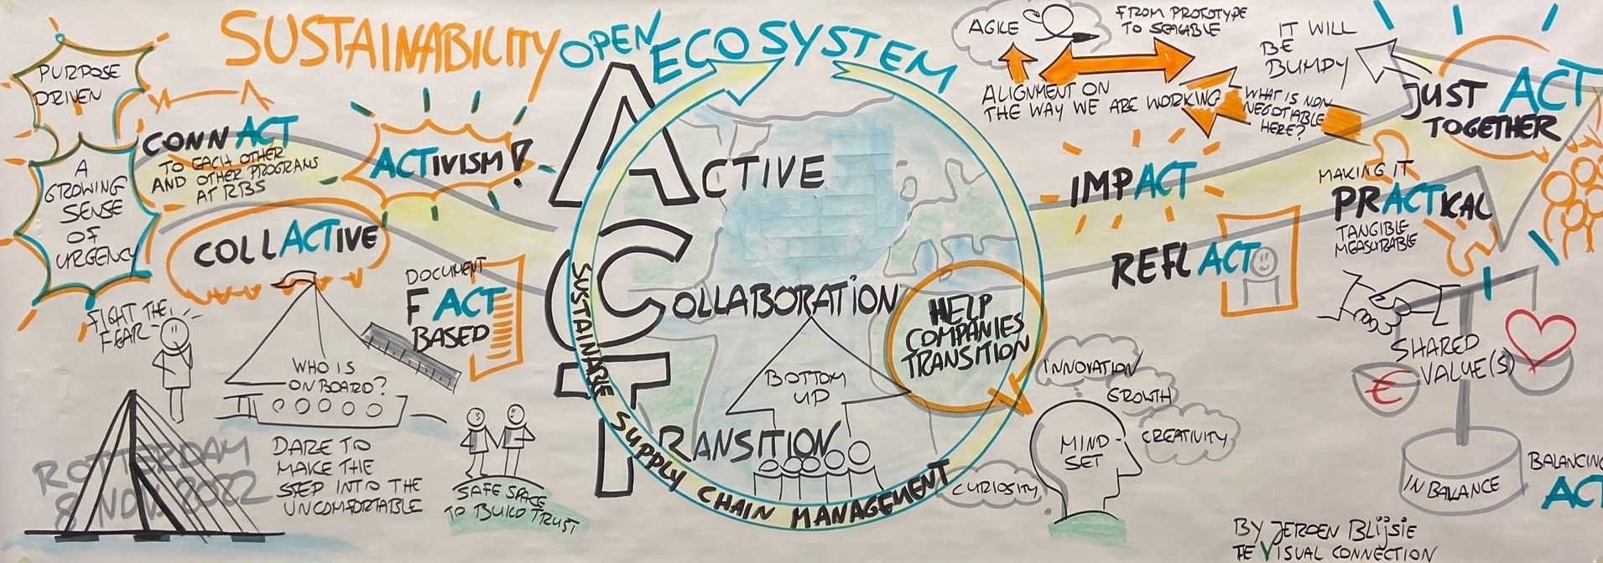
What ACT is all about – What makes us tick?
Passion for sustainability
Collaboration
Curiosity ->
Research
Engagement ->
Action

Slide 5
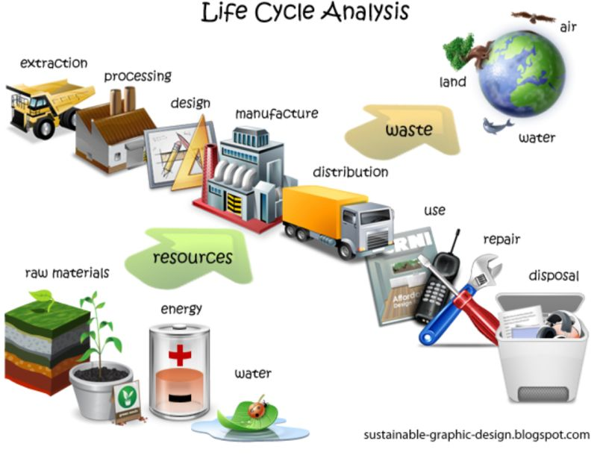
Students said about ACT
LCA is mightier than the sword. ✏️🗡️
“[…] This is a war against time, against the end of resources, against the rise of the ocean level, it’s our last war, and we need to prepare by making informed decisions. Let’s start with analyzing product life cycles to change the future. Let’s show those LCA.”
(Andrea Ballester, MSC student)

Slide 6
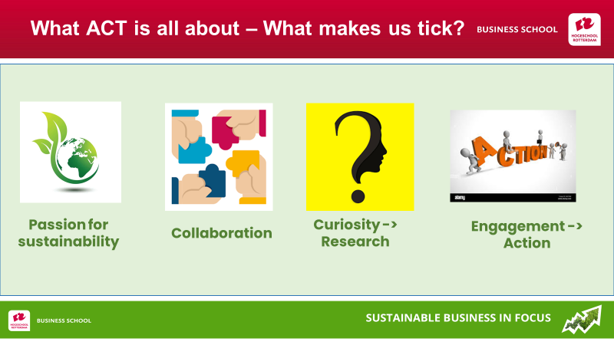

Educational innovation for sustainable development
We practice what we preach!
We transform the education so that it can become transformative in nature!

