Slide 1






Girls Go Circular
Digital and Entrepreneurial Skills for the
Circular Economy
Solène Moutier, 15.11.2023
Coordinated by

Slide 2
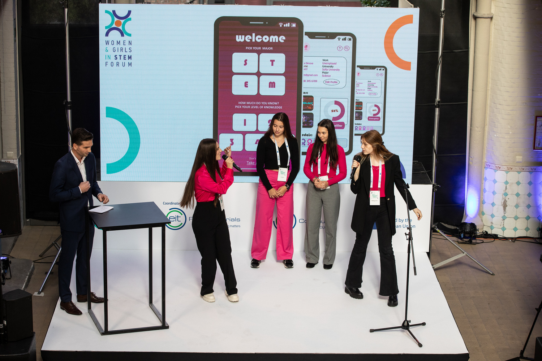

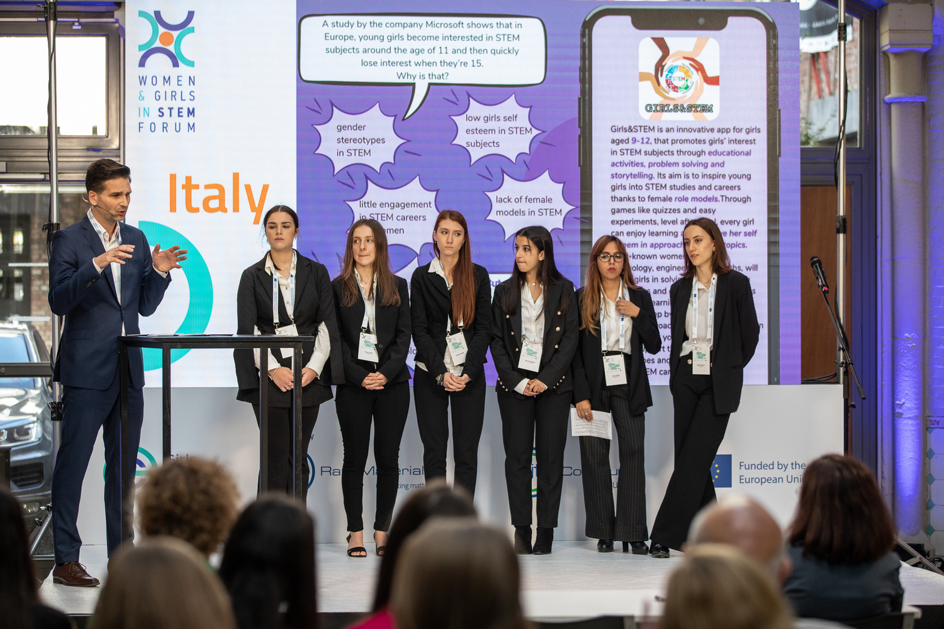

Project Overview
  Girls Go Circular is coordinated by EIT RawMaterials since 2020, with the support of the EIT Community and the Directorate-General for Education, Youth, Sport, and Culture (DG EAC).
  The project aims to equip at least 40,000 schoolgirls aged 14-19 across Europe with digital and entrepreneurial skills by 2027 through an online learning programme about the circular economy.

Slide 3

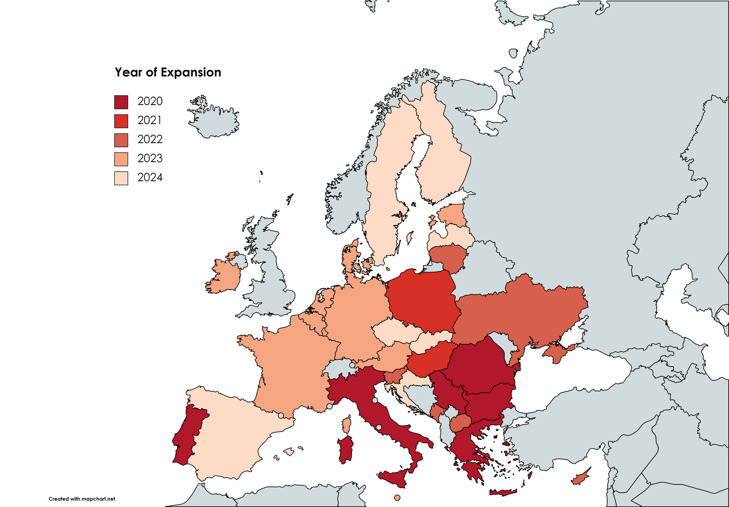

Project Expansion
+28,000
girls
1,000
schools
23
countries
16
languages

Slide 4

Policy Objectives
01
Digital Education Action Plan
02
New European Innovation Agenda
Girls Go Circular contributes to Action 13 – Encourage Women’s Participation in STEM.
The project closely supports EIT’s flagship Deep Tech Talent Initiative.
03
Closing the Gender Gap in STEM and ICT
04
Supporting EIT's efforts in Ukraine
The Women and Girls in STEM Forum, Girls Go Circular's flagship event, guides annually high-level discussions to advance the EU agenda on these topics.
Girls Go Circular is active in several Ukrainian cities, supporting the students affected by war.

Slide 5
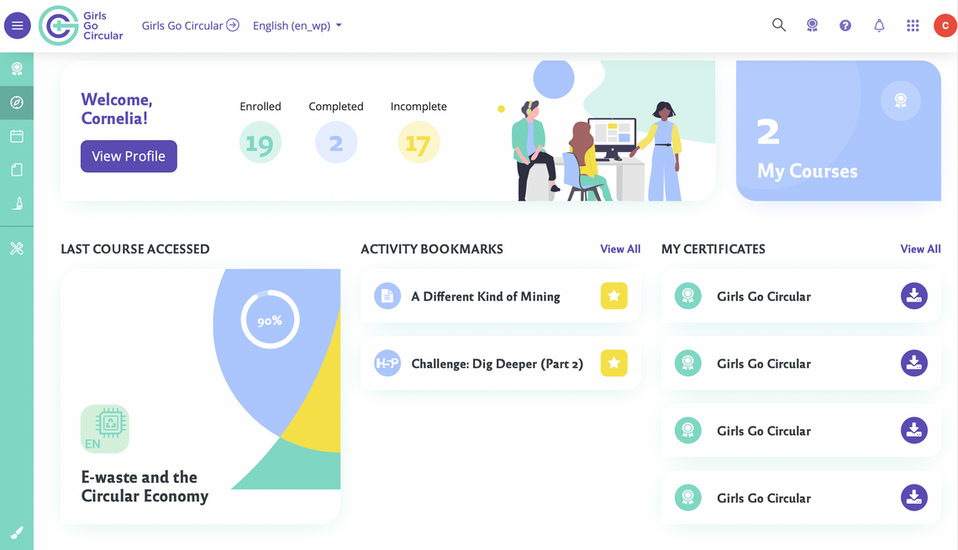

Learning Platform & Methodology
  Circular Learning Space is Girls Go Circular’s online learning platform:
    18 learning modules exploring digital tools and the circular economy in different industries
    +60,000 registered users
  The teaching methodology is based on a learning-by-doing approach which engages students in challenge-based exercises such as creating an app mock-up, developing a product prototype, or planning a business model.

Slide 6
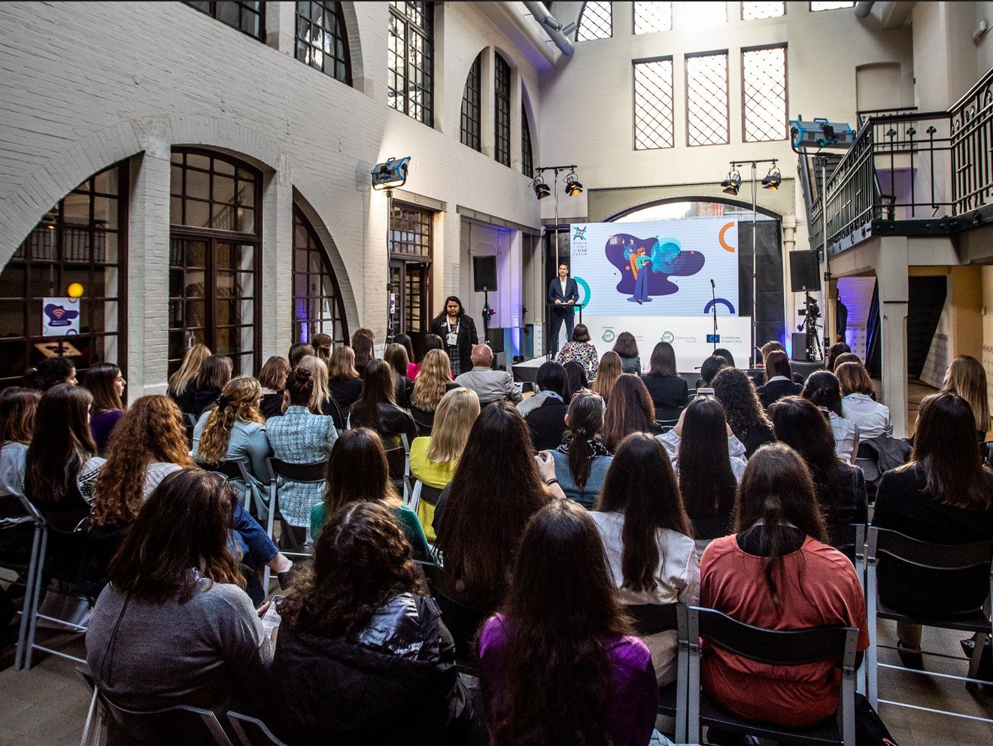
Women and Girls in STEM Forum
  The Forum gathers annualy researchers, policymakers, and influential stakeholders in STEM and ICT and connects them with the students who participate in Girls Go Circular’s learning programme.
  Third edition comming soon: 5 December 2023.
  The Forum's Policy Brief highlights important European policies and initiatives to reduce gender bias in STEM and ICT and empower women in taking an active role in the twin green and digital transitions.

Slide 7
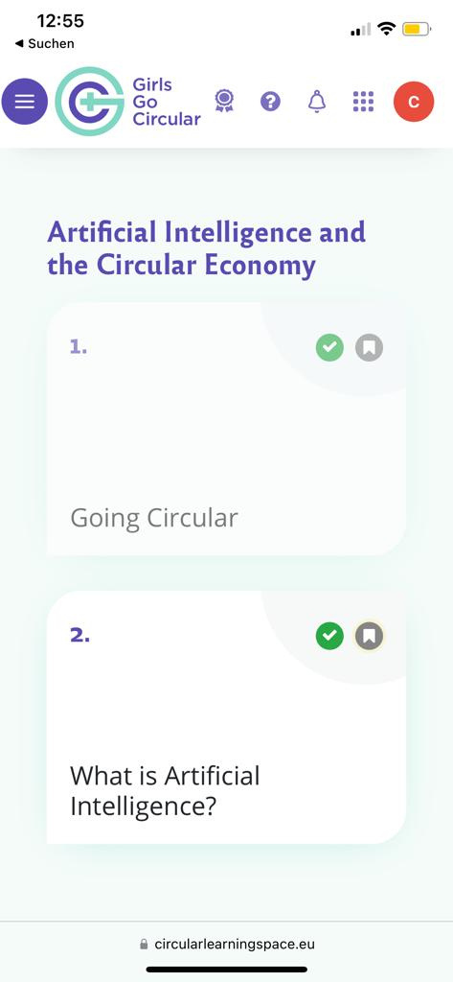
Join Us!
"This programme should be compulsory in schools everywhere. However, you have only just started. You have to do this again and again until everybody has become aware of these things. Join forces with institutions and local authorities and re-run this programme for as many times as necessary. Make it more public where it has only reached a minority so far."
– Girls Go Circular Participant

Slide 8
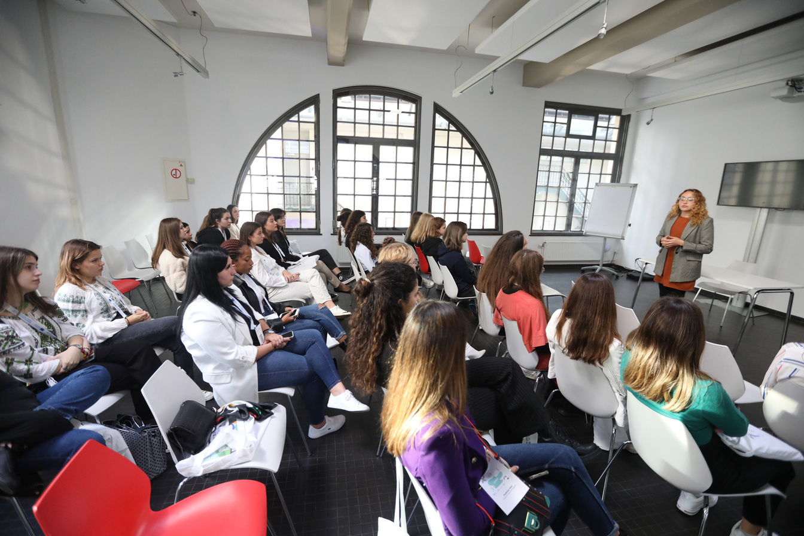

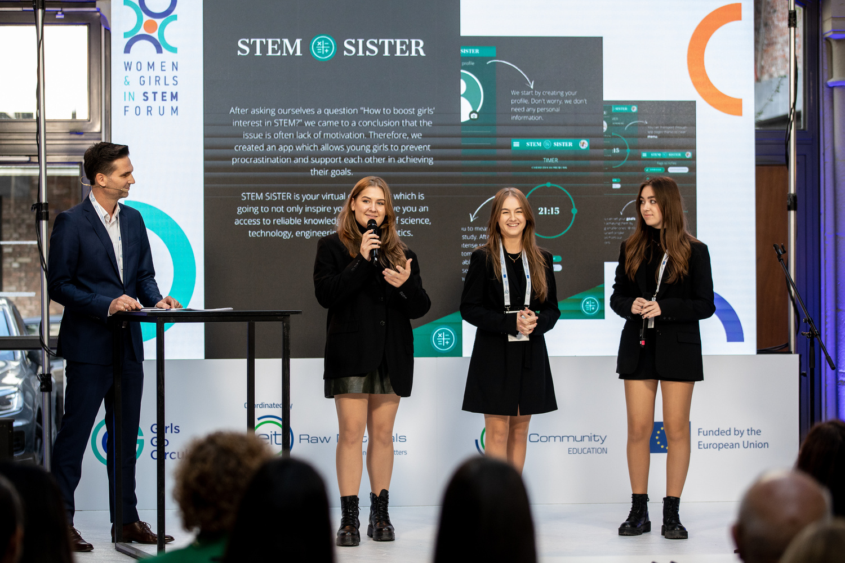




Contact Details
+49 1723782709
girlsgocircular@eitrawmaterials.eu
https://eit-girlsgocircular.eu
Europaplatz 2, 10557 Berlin
Coordinated by

