Slide 1
EUTeens4Green A new generation of youth ambassadors for inclusive green transition
REGIO.E.1 – Administrative Capacity Building and Solidarity Instrument

Slide 2
Objectives
Explore willingness of young people to participate in shaping EU cohesion policy
Focus of young people (15-24 years old) living in Just Transition territories
Investigate on their capacity to participate
Identify people at risk of exclusion from the green transition and implement solutions for inclusion
Understand the conditions for attract their interest and motivate to participate
Evaluate youth capacity to implement projects of value EUR10.000 in 12 months.

Slide 3
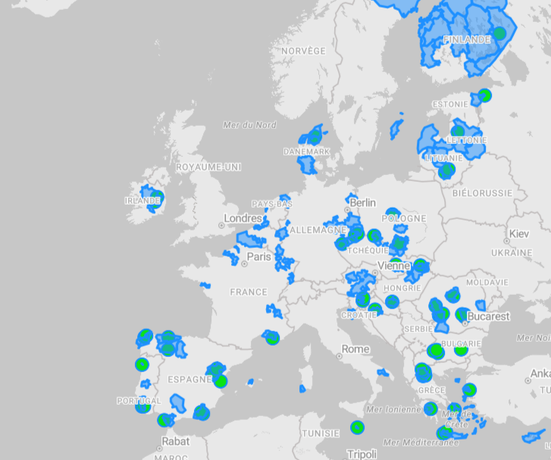
69 projects, more than 250 young people
Environment hero course
« Green out of the box » challenge

Slide 4
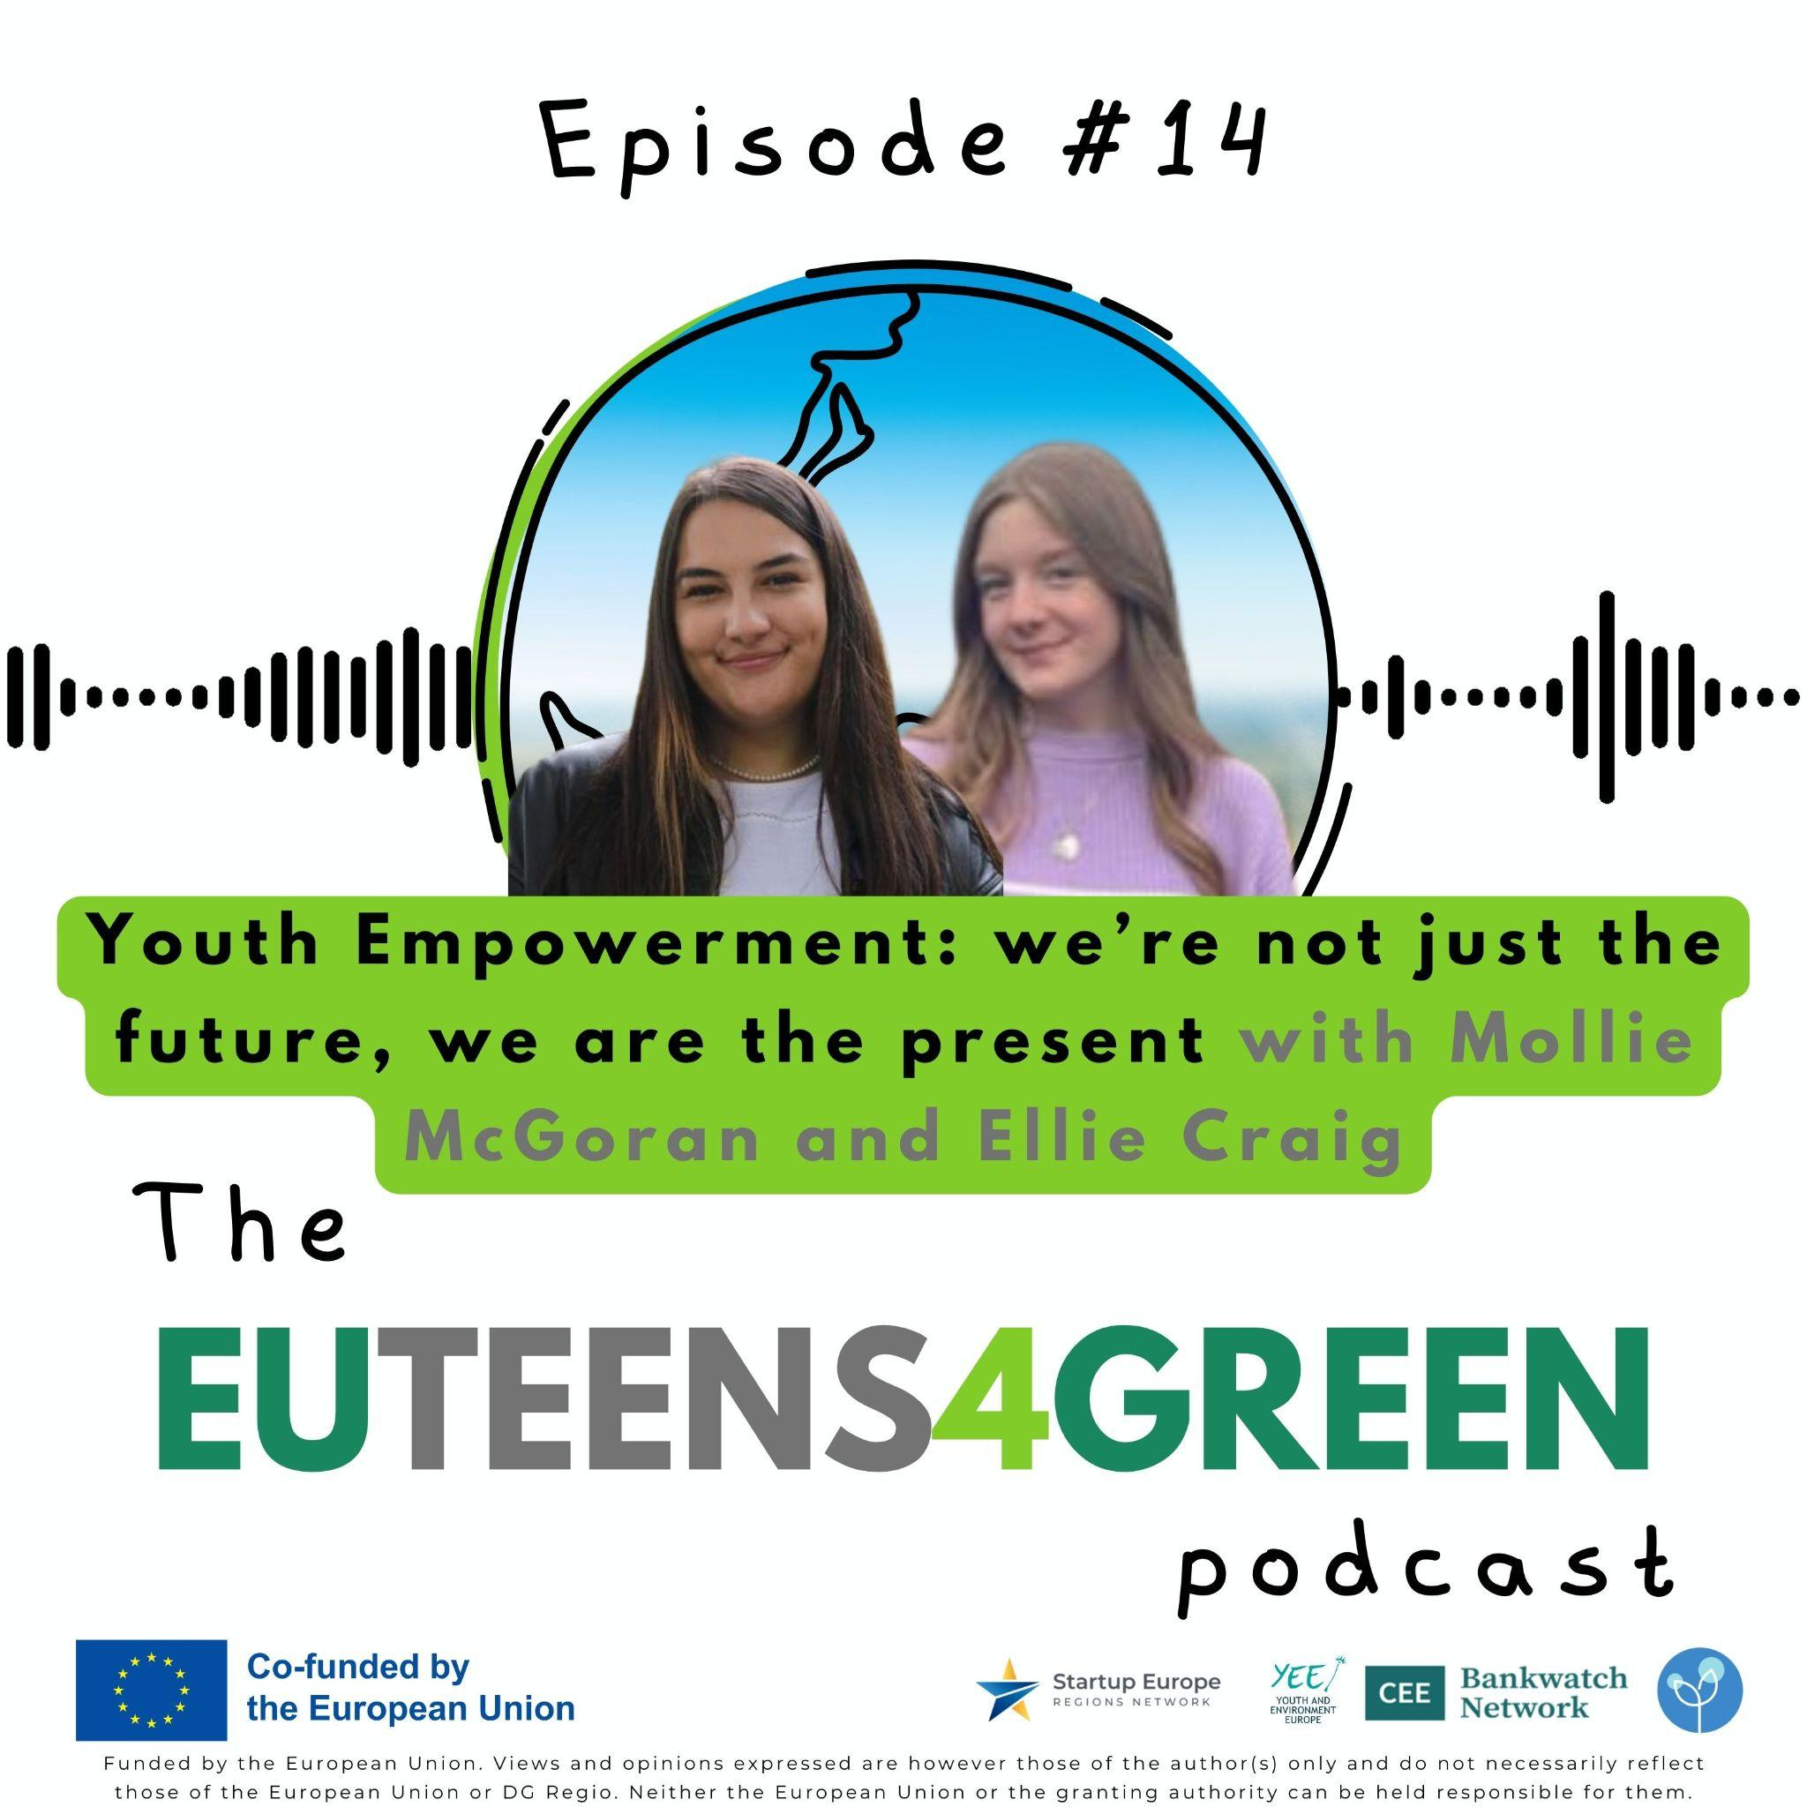
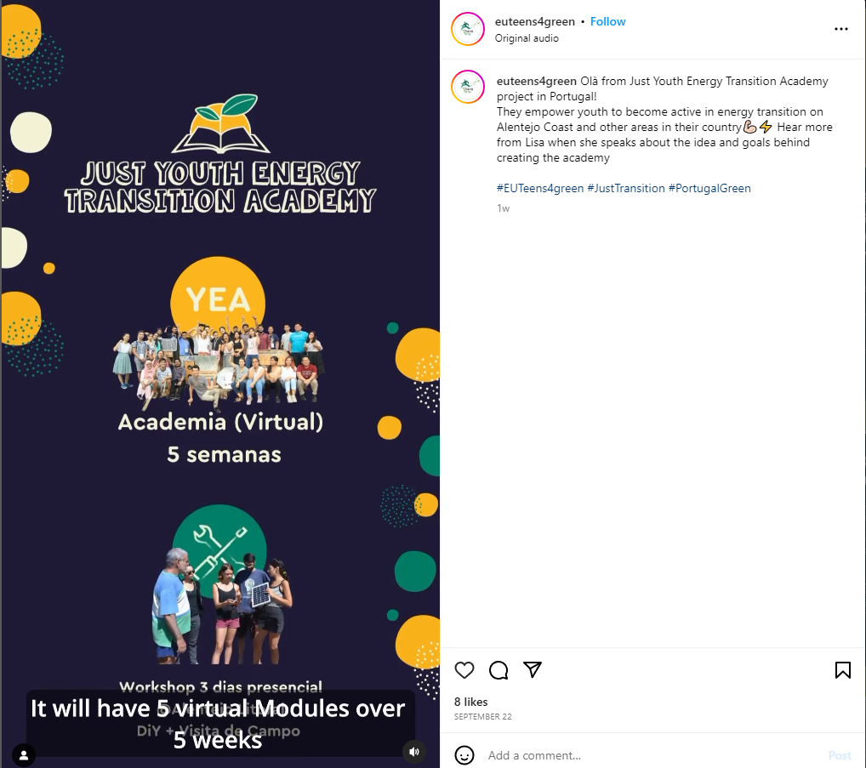
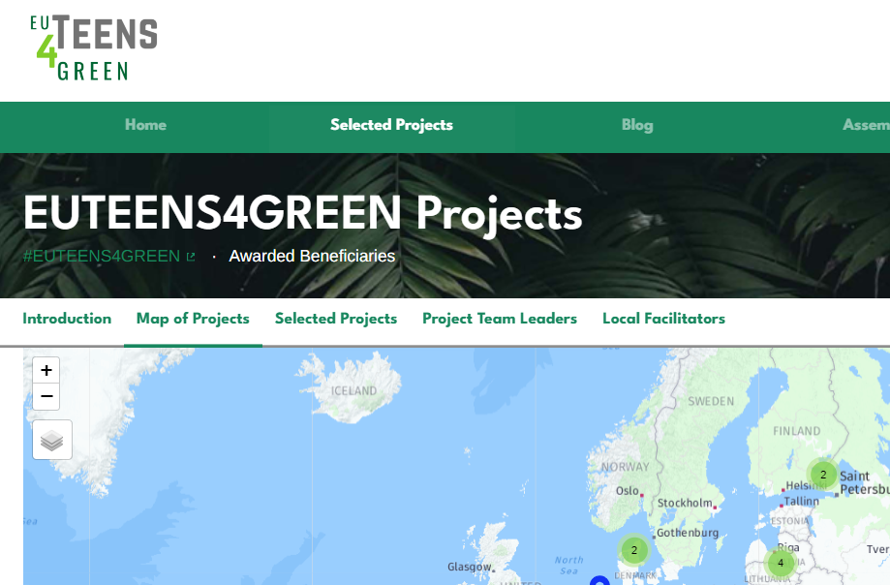
How to follow EUTeens4Green
https://participate.euteens4green.org/
@EUTeens4green on social media

Slide 5
Thank you for the attention

