Slide 1
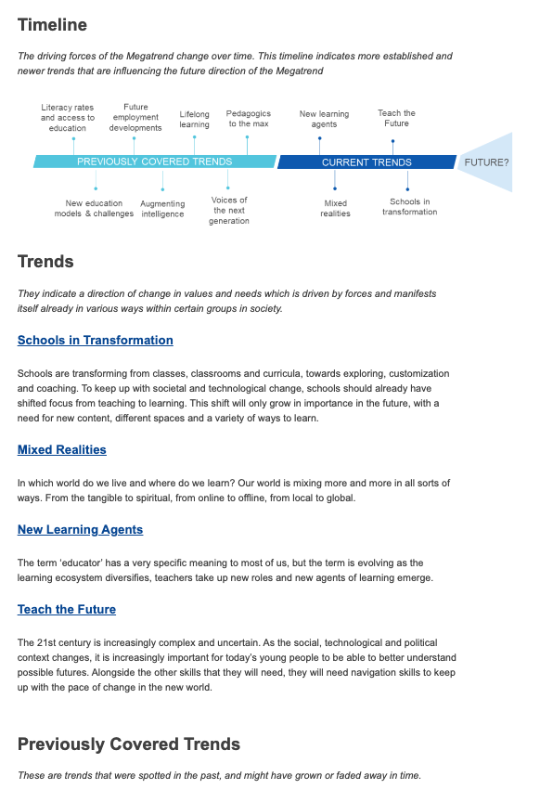
Notes:
https://knowledge4policy.ec.europa.eu/diversification-education-learning_en

Slide 2
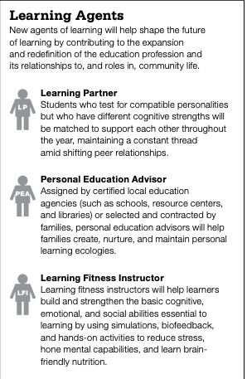
Notes:
https://knowledgeworks.org/wp-content/uploads/2018/01/2020-forecast.pdf
https://knowledgeworks.org/wp-content/uploads/2018/01/2020-forecast-update.pdf

Slide 3
Report content
Objectives and scope
Conceptualization
Key factors of change of the school education in the EU
Alternative scenario narratives
Scenario implications for the school education in the EU
Recommendations and conclusions
By European Commission – Directorate General for Education, Youth, Sports and Culture
Link:https://op.europa.eu/en/publication-detail/-/publication/43990e75-bf35-11ee-b164-01aa75ed71a1
Notes:
https://op.europa.eu/en/publication-detail/-/publication/43990e75-bf35-11ee-b164-01aa75ed71a1

Slide 4
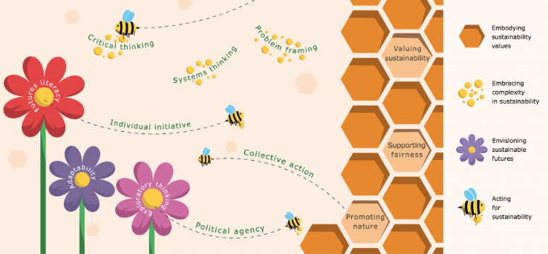
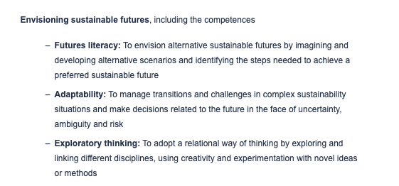
Notes:
https://joint-research-centre.ec.europa.eu/greencomp-european-sustainability-competence-framework/greencomp-conceptual-reference-model_en

Slide 5
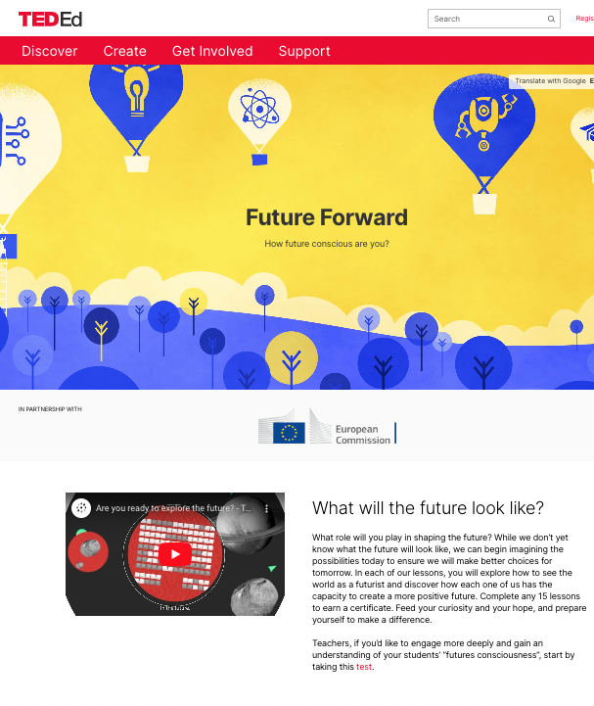
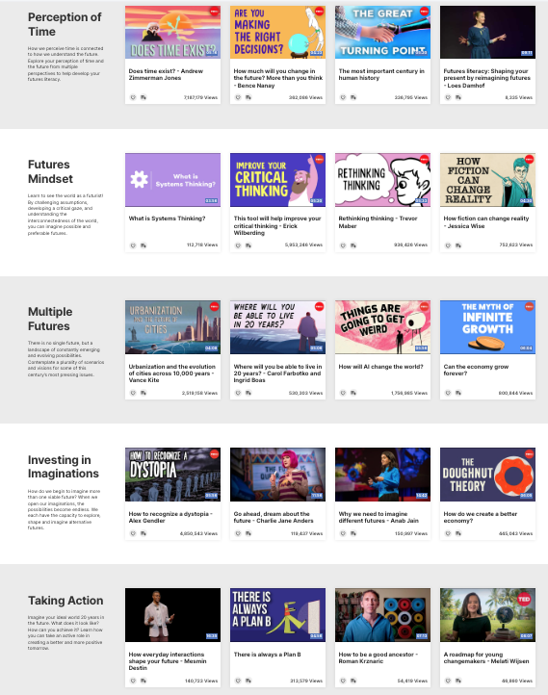
Notes:
https://ed.ted.com/future-forward

Slide 6
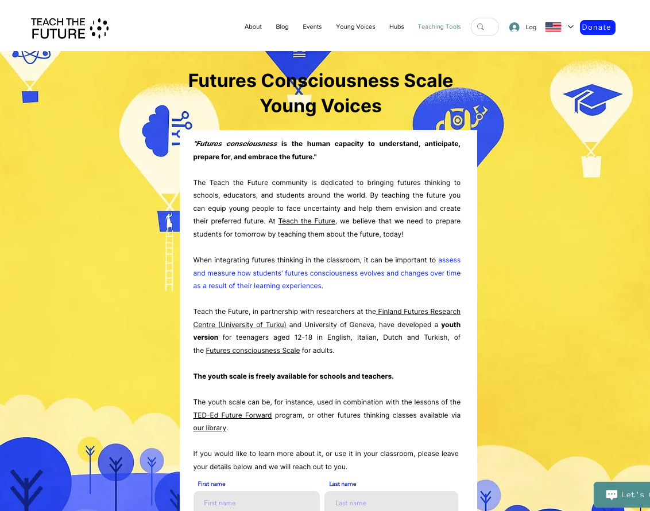
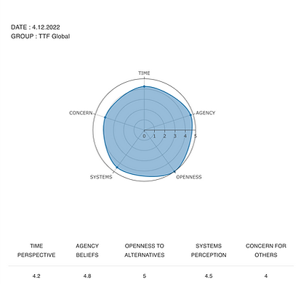
Notes:
https://www.teachthefuture.org/futures-consciousness-scale-young-voices

