Slide 1





How to approach AI and climate change in learning communities
Maëlysse Billard
YOUTH
CLIMATE
LAB 2
Kyriaki Maria Papadopoulou
Sonia Artesani

Slide 2

INTRODUCTION TO OUR LEARNING SCENARIO
  Focus: AI, climate change, and sustainability
  Features business simulation on ecological impacts
  Emphasizes real-world use and critical thinking

Slide 3
PURPOSE AND AUDIENCE
  Goal: Empower high school students (15-17) to use AI for sustainable climate action
  Topics covered:
- AI in environmental protection
- Sustainable business practices
- European Commission guidelines on sustainability

Slide 4



STUDENTS PRODUCE
Through a Game generated by AI:
  sustainable business projects
  weekly reports on business decisions and their ecological impact
  reflection on the effectiveness of their learning and business decisions.
The greener the business decisions are, the more points students earn.

Slide 5


RELEVANCE
  links to real-life business practices and European Commission guidelines on sustainability.
  provides students practical knowledge and skills that are directly applicable to real-world scenarios.

Slide 6



COMPETENCES THAT ARE DEVELOPED
Green Competences
Digital Competences
System thinking
  Searching and managing data, information and digital content
  Interacting and engaging in citizenship through digital technologies
Critical thinking
Political agency
Collective action
Individual initiative

Slide 7

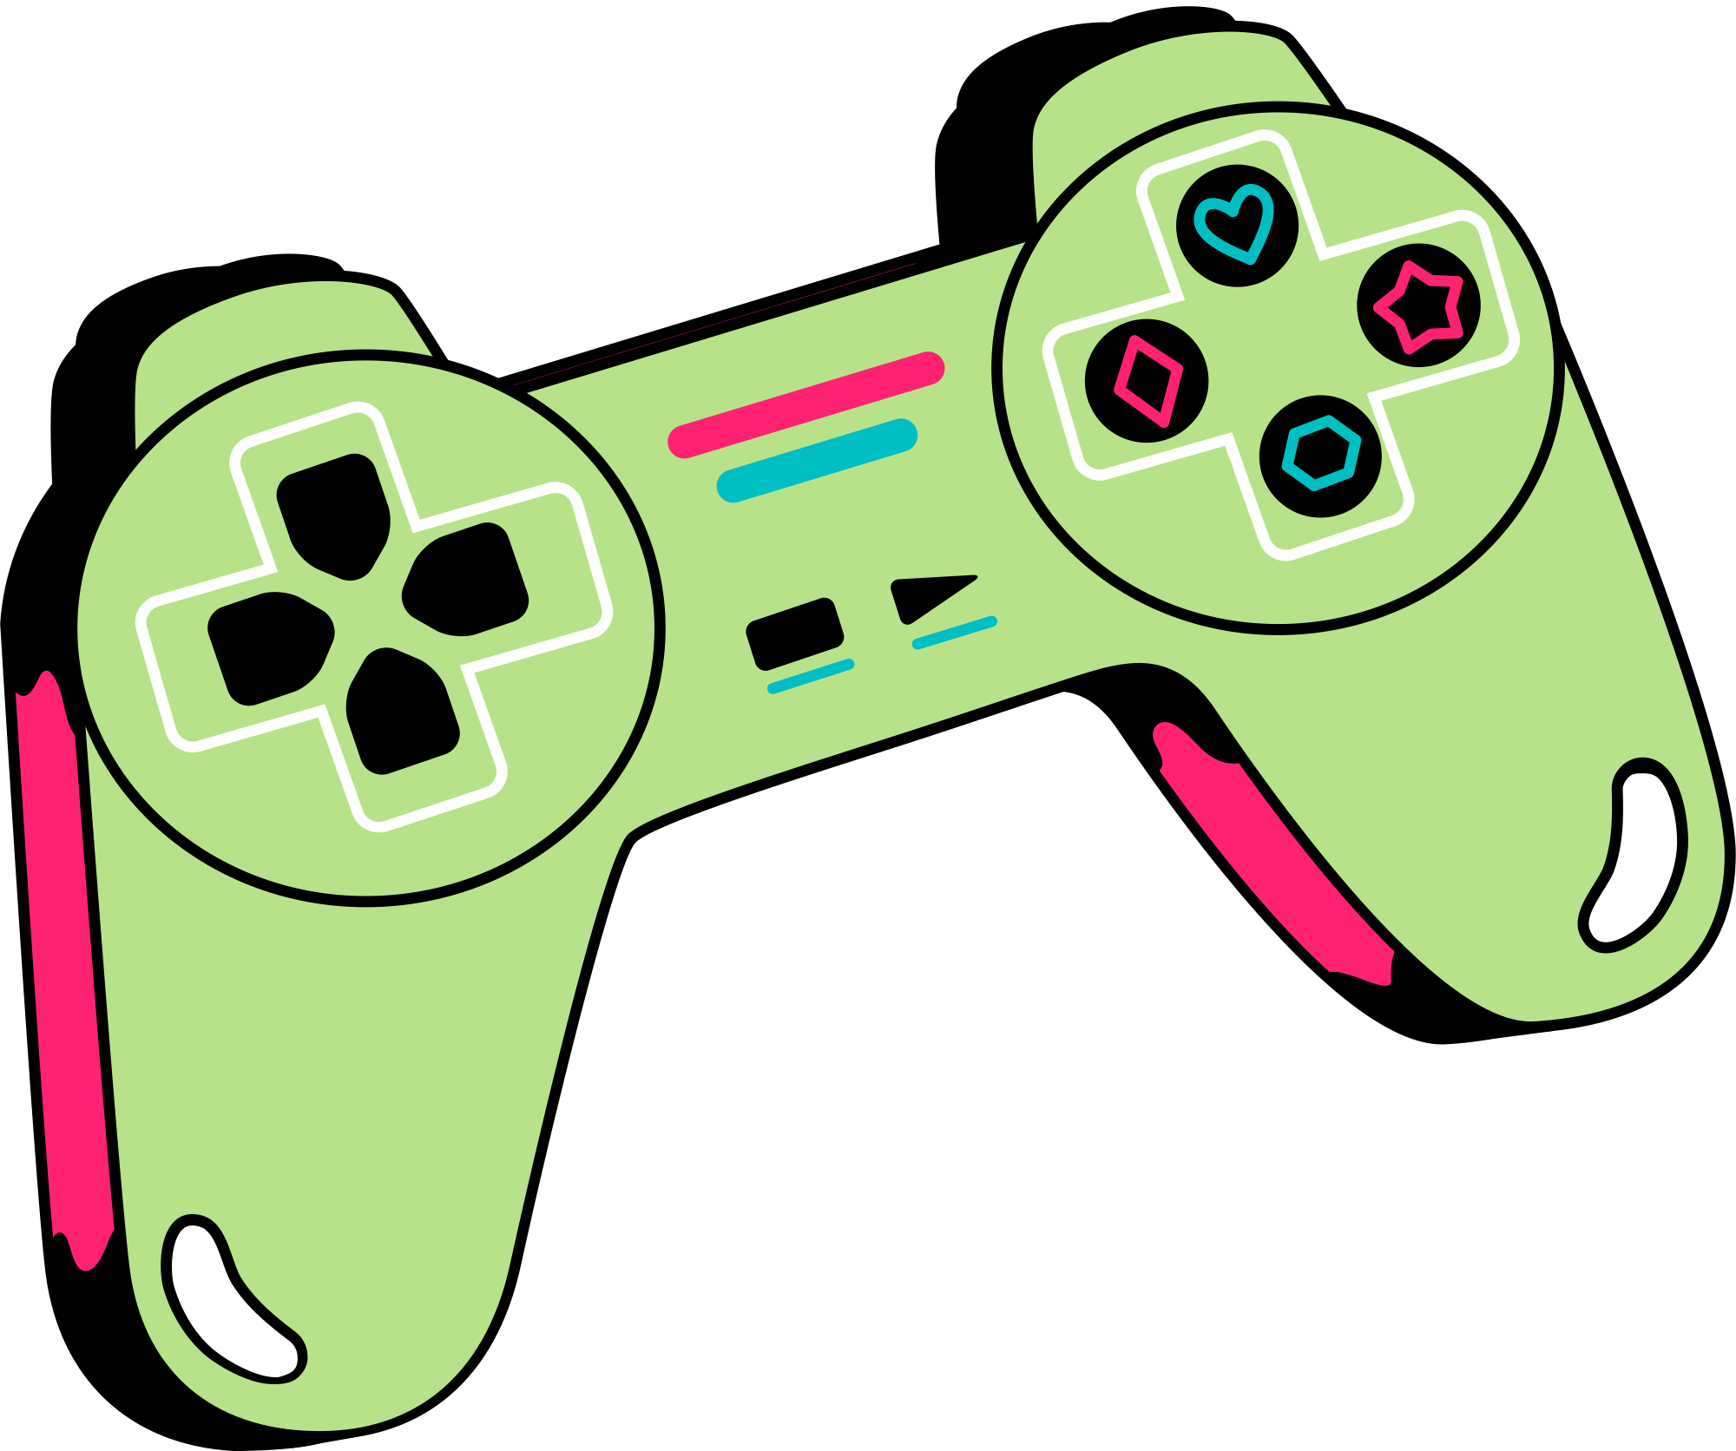

Education for climate innovation areas
Learning methodologies
  Raising Awareness
  Developing green skills and competences
  Changing behaviours
  Project-based learning
  Value Creation Pedagogy
  Play-based learning

Slide 8

ACTIVITY OVERVIEW
Involved
Students
Teachers
Parents
Stakeholders
Space
Online
In person
Accessible via tablets and PCs

Slide 9


TOOLS AND RESOURCES
Digital tools
  Tablets
  PCs
  AI tools and platforms
Physical Materials
  Sustainable materials
  Cardboard materials

Slide 10
ROADMAP
Preparation
Activity
2-3 hours per week
2 sessions - 45 minutes
4 weeks
Educators:
  Familiarize with AI tools
  Evaluate students' progress
Week 1:
Introduction to AI and Sustainability.
Week 2:
Business Development and Decision-Making.
Week 3:
Implementing Sustainable Practices.
Week 4:
Final Evaluation and Reflection.
Students:
  Researching
  Decision-making
  Preparing reports

Slide 11


ASSESSMENT METHODS
Automated Assessment
Quizzes at the end of each class and a comprehensive quiz at the end of the course.
Self-Reflection
Evaluation from students of their learning, decision-making effectiveness and the impact of the project.
Questions for Learning
Open-ended questions for active learning and critical thinking.

Slide 12
Thank you for your attention!

